Slide 1

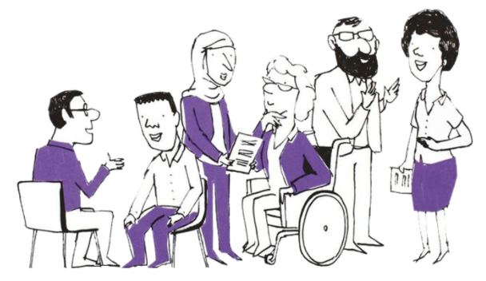

PPN NW and NE&Y NHS Talking Therapies Leadership and Innovation Forum
Spring 2026
23rd April 2026

Slide 2

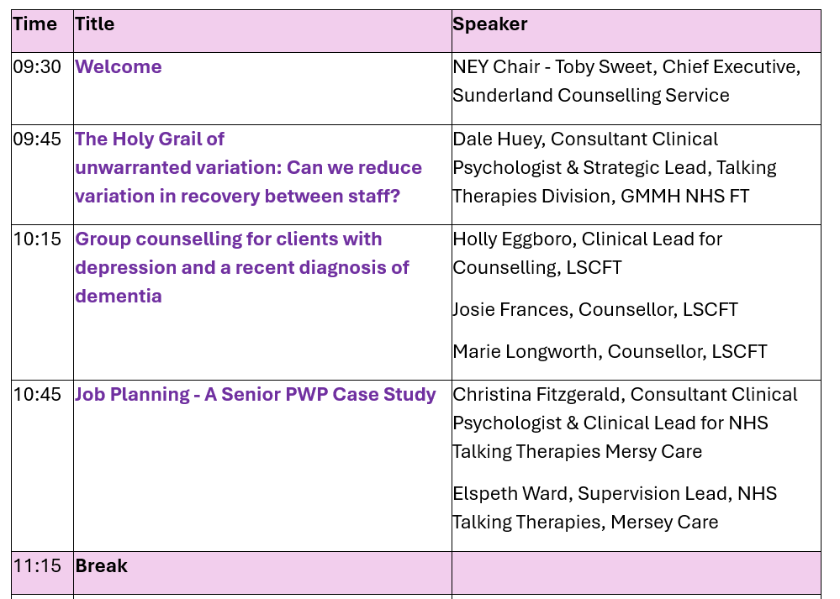
Welcome:
Agenda
Time | Title | Speaker
09:30 | Welcome | NEY Chair - Toby Sweet, Chief Executive, Sunderland Counselling Service
09:45 | The Holy Grail of unwarranted variation: Can we reduce variation in recovery between staff? | Dale Huey, Consultant Clinical Psychologist & Strategic Lead, Talking Therapies Division, GMMH NHS FT
10:15 | Group counselling for clients with depression and a recent diagnosis of dementia | Holly Eggboro, Clinical Lead for Counselling, LSCFT Josie Frances, Counsellor, LSCFT Marie Longworth, Counsellor, LSCFT
10:45 | Job Planning - A Senior PWP Case Study | Christina Fitzgerald, Consultant Clinical Psychologist & Clinical Lead for NHS Talking Therapies Mersy Care Elspeth Ward, Supervision Lead, NHS Talking Therapies, Mersey Care
11:15 | Break
11:30 | Use of Virtual Patients in PWP Training | Dr Paul Thompson, Senior Lecturer in Mental Health, Teeside University
12:10 | Research in Relapse Prevention and Patient Experience | Dr Cintia Faija, Lecturer in Clinical Psychology, University of Liverpool & Peter Bampton, PPI
12:50 | Closing Remarks | NW Chair – Dale Huey, Consultant Clinical Psychologist & Strategic Lead, Talking Therapies Division, GMMH NHS FT
Notes:
Liz

Slide 3
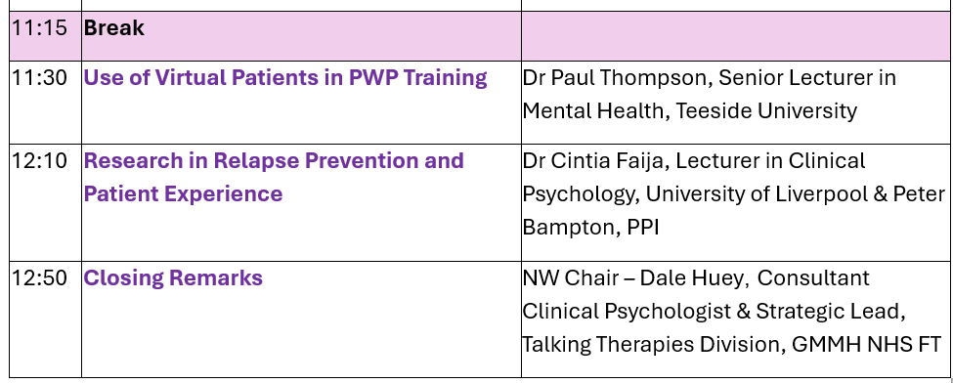
Welcome:
Agenda
Notes:
Liz

Slide 4
Housekeeping
Recording of today’s session
Please keep mics muted
To engage:
  Reactions
  ‘Q&A’ – ‘like’ to uplift a question
Evaluation Survey
  Will be sent out after the event
Chat Function
Please use the Q&A function to pose your questions for our presenters, as we go.
This will enable us to capture key themes and ideas to ensure we cover as much as possible in the Q&As at the end of the sessions.
Notes:
Liz

Slide 5


Talking Therapies
for anxiety and depression
The ‘Holy Grail’ of unwarranted variation: can we reduce variation in recovery between staff?
Dr Dale Huey
Clinical Lead: Talking Therapies, NHS GM

Slide 6

“Leaders create clarity about expectations and what success looks like in order to focus people’s energy, give them the freedom to self-manage within the demands of their job, and deliver improving standards of care and service delivery.”
Healthcare Leadership Model
“If you want others to be happy, practice compassion. If you want to be happy, practice compassion.”
Dalai Lama
Concilio et labor:
By wisdom and effort.
From Ecclesiasticus 37:16: Let reason go before every enterprise, and counsel before every action.
Reducing unwarranted variation between staff
(1) ‘Tilting at windmills’
What is our purpose?
The burden of Common Mental Health Conditions
Knights without shining armour
(2) Easing the burden of CMHC: reducing unnecessary suffering
Common Mental Health Conditions: the impact
Are things getting better for people with CMHC?
Does leadership matter? Is it similar to therapy?
(3) Cart before the horse: what were the results?
Time 1 versus Times 2 on key measures
(4) What made the difference?
Practitioner Dashboards
Practitioner Focus Groups
Perspective that matter most
Notes:
Purpose: in terms of TTad, but worth bearing in mind that Frankl’s three things which give a concrete meaning to personal existence: love, work (making a difference), and tolerating adversary/finding meaning in suffering.

Slide 7

Talking Therapies for anxiety and depression
The case for expanding evidence-based psychological therapies—originally proposed by Layard (2006) argued that such provision of sufficient evidence based psychological interventions could help lift half of those affected by CMHC (all severities included) out of depression or chronic anxiety. This promise formed the basis of the initial, and ultimately persuasive, argument for what became the Improving Access to Psychological Therapies programme (IAPT), first implemented within the NHS in 2008 to address what Lord Layard described as Britain’s greatest social problem. The programme was rebranded as NHS Talking Therapies: for anxiety and depression in 2023, following a public consultation.

Slide 8
Common Mental Health Conditions: anxiety disorders and depression
Source
Adult Psychiatric Morbidity Survey: Survey of Mental Health and Wellbeing, England, 2023/4 - NHS England Digital
WHO, Global Disease Burden 2020-21: Leading causes of DALYs
Mental health remains England’s leading health concern (45% of respondents).
21% of adults in England reported a mental health problem.
20% had a common mental health condition (CMHC), i.e. an anxiety disorder and/or depression, while 1% of the population live with a severe mental illness (0.5% a psychotic disorder).
Disability-Adjusted Life Years (DALYs) measure the total burden of disease. CMHC are a top cause of DALYs mainly due to years lived with disability (YLDs).
In Europe (2020) 11.0 million years of healthy life lost due to anxiety- and depressive-disorders; 2.9m lost to Schizophrenia and Bipolar Disorder (for further comparison: lung cancers 10.4m, breast cancer 4.5m, Alzheimer’s/other dementias 3.7m).
Notes:
20 years on.

Slide 9
Common Mental Health Conditions: 2023-24 England
Source
Adult Psychiatric Morbidity Survey: Survey of Mental Health and Wellbeing, England, 2023/4 - NHS England Digital
The proportion of young adults (16-24) in England with a CMHC is 25.8%, an increase of over 8% since 2007.
More people (16-74) with a CMHC are receiving psychological therapy; 17.9%, an increase of over 7% since 2007.
People living with a CMHC rated as severe has increased, over 3% since 2007, to 11.6% (16-64).
Of those with severe symptoms, 14% asked for treatment in the past year but did not receive it.
Since 2007 treatment via medication increased over 18% to 38.4%.

Slide 10
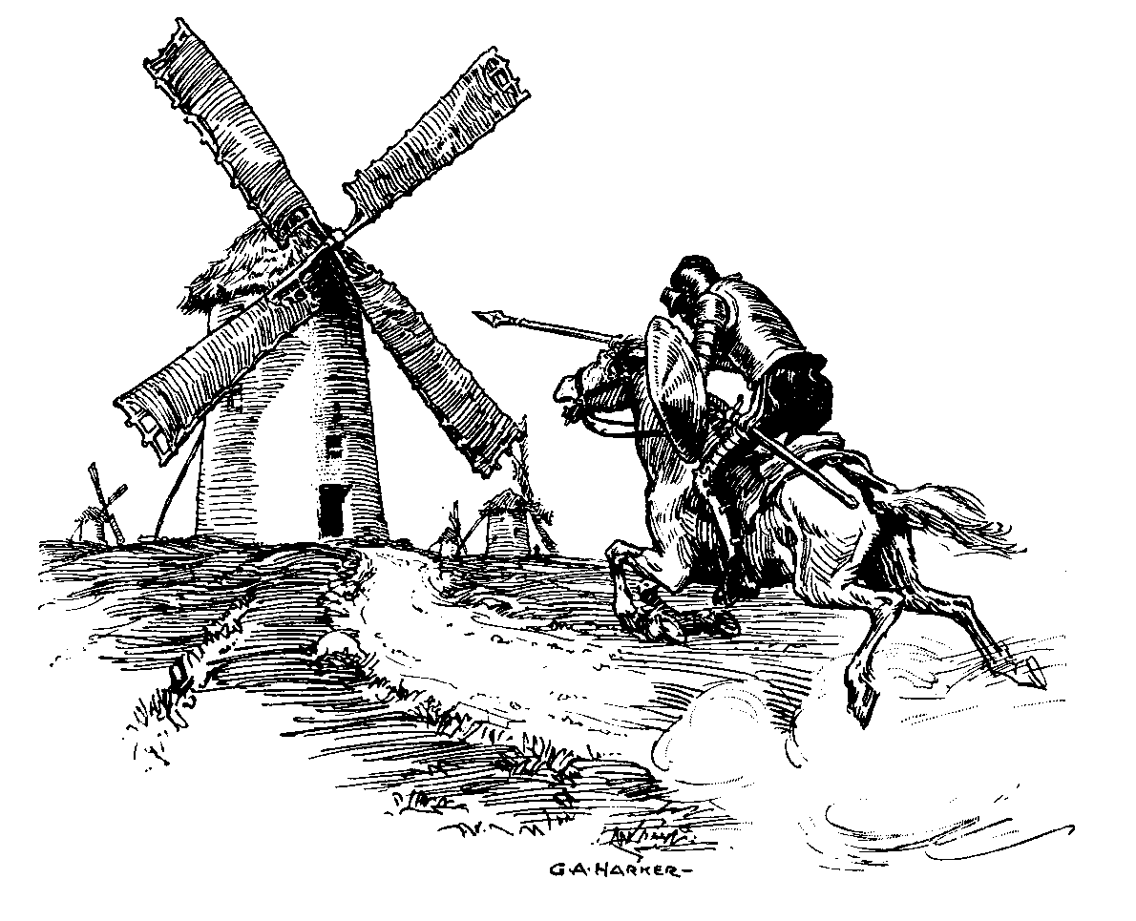
Don Quixote who after reading many tales of derring-do in romantic medieval novels, develops unusual ideas fuelled by idealism. He proclaims himself protector of the vulnerable and ventures out to right wrongs, help the oppressed, ensure justice, and revive chivalric values in his modern world. Often confusing reality with fantasy and fighting imagined evils like giants (windmills), murderous hordes (flocks of sheep), and besieged castles (coaching inns).
Don Quixote (1605) Miguel de Cervantes (1547-1616)
Notes:
My mixed Chivalric metaphors… is trying to capture that the route towards greatly desired ultimate achievements—such as addressing biggest greatest social problem and the greatest concern to our population, that is helping people resolve their crippling anxiety and wretched depression—is strewn with opportunities to misread the task and end-up tilting at windmills. Wasting effort on imaginary or less central aspects of the task; trying to tackle the wrong things and often doing it badly.

Slide 11

Leadership
Intentional influence exerted to guide, structure, and facilitate activities and relationships in a group or organisation.
(Yukl, 2013)
Notes:
Compassionate Collective Leadership and Accountability: What does good look like?

Slide 12
Individuals
Core needs people have at work
Need for belonging
  conferred by feeling valued
Need for feeling competent
  conferred by sense of control and feedback
Need for autonomy and control
  Including sense of work being congruent with values and sense on integrity

Slide 13
Real teams
Effective communication
Open and honest communication is vital
Leaders of teams need to create a safe environment
Reflect on meetings, are they achieving what they are meant to?
Take time, listen, ‘hold up the mirror’ re our own communication
Creating real teams within a compassionate culture
  A shared vision: around delivering high quality care
  Simplified strategic priorities
  Shared goals (common purpose)
  Limited number of clear objectives for every individual: aligned to the collective sense of purpose
  Leaders creating a feedback rich environment by providing data to real teams
  Good relationships: feeling known and valued by colleagues
Resource
See work of Michael West, e.g.
http://www.rcn.org.uk/__data/assets/pdf_file/0008/568880/West_keynote_research_2014.pdf
West, M. It doesn’t have to be this way. The Psychologist, August 2019.
Notes:
The common purpose here is using what we have, to the best of our ability, to help people recover; and doing it in a way which engages and supports the most important assets. Our patient facing colleagues.

Slide 14

Unwarranted variation: NHS Aim
To understand, address and eliminate unjustified differences in healthcare quality, access, and outcomes.
For NHS Talking Therapies, developed on the promise of reducing the unnecessary suffering associated with CMHC, a priority has to be reducing unwarranted variation in outcomes.

Slide 15

What is the current situation?

Slide 16
Talking Therapies ‘Service 5’: recovery variation Step 3
Notes:
All that is attended to KPI wise is either is the overall pathway average, or the ‘Step’ average in this case a mid-forties recovery figure for 12 months. Masks considerable and unwarranted variation. Unwarranted as in each staff group, whether CBT and Counselling, are ostensibly drawing from the same waiting list. So it would be reasonable to expect that patient factors which impact on recovery (positively and negatively) over a long enough time period would be relatively evenly distributed.

Slide 17
Recovery figures, Step 3, Time 1 (n=250)

Slide 18
Distribution of percentage recovery by service: Step 3 staff, Time 1
Recovery % (n staff) | Service 1 | Service 2 | Service 3 | Service 4 | Service 5 | Service 6 | Service 7
>60% | 2 | 6 | 5 | 5 | 9 | 14 | 5
55-59 | 0 | 4 | 3 | 4 | 2 | 4 | 3
50-54 | 3 | 7 | 1 | 5 | 4 | 6 | 2
45-49 | 5 | 5 | 2 | 4 | 4 | 9 | 2
40-44 | 4 | 6 | 6 | 2 | 9 | 6 | 3
35-39 | 1 | 3 | 6 | 4 | 7 | 1 | 5
30-34 | 1 | 0 | 6 | 6 | 4 | 4 | 3
<30% | 10 | 2 | 4 | 7 | 7 | 2 | 5
n staff | 26 | 33 | 34 | 37 | 46 | 46 | 28
Ave | 38% | 49% | 44% | 44% | 44% | 53% | 43%
>49% | 19% of staff | 52% of staff | 26% of staff | 38% of staff | 33% of staff | 52% of staff | 36% of staff
<35% | 42% of staff | 6% of staff | 29% of staff | 30% of staff | 24% of staff | 13% of staff | 29% of staff
Notes:
35 staff below 30%
89 staff >=50%

Slide 19
What options did we have and what did we do about this?
We opted to engage low performing and high performing staff, establish their views and enlist their efforts. Interventions included:
Practitioner Dashboard: Implemented March 2024, providing individualized performance metrics.
Practitioner Focus Groups: Conducted July–Aug 2024, using the GROW model to explore reasons for variation and generate improvement strategies.
Notes:
I’ll say more about the GROW model in a few minutes. But in a slightly cart before the horse, or squire before the knight way, here are the headline results.

Slide 20
Recovery figures, Step 3, Time 2 (n=276)
Notes:
Green segment. Step 3 outcomes only so 45+ seems valid cut-off for pathway goal of 50%.

Slide 21
Distribution of percentage recovery by service: Step 3 staff, Time 2
Recovery % (n staff) | Service 1 | Service 2 | Service 3 | Service 4 | Service 5 | Service 6 | Service 7
>60% | 8 | 12 | 4 | 10 | 9 | 23 | 12
55-59 | 1 | 3 | 1 | 4 | 5 | 5 | 6
50-54 | 5 | 5 | 4 | 6 | 5 | 4 | 4
45-49 | 4 | 4 | 6 | 4 | 1 | 5 | 4
40-44 | 3 | 6 | 4 | 7 | 10 | 5 | 3
35-39 | 3 | 3 | 4 | 6 | 6 | 4 | 3
30-34 | 2 | 2 | 5 | 3 | 4 | 0 | 1
<30% | 1 | 6 | 6 | 5 | 6 | 0 | 4
n staff | 27 | 41 | 34 | 45 | 46 | 46 | 37
Ave Staff Rec. | 51% | 49% | 41% | 50% | 46% | 59% | 53%
>49% | 52% of staff | 49% of staff | 27% of staff | 45% of staff | 41% of staff | 70% of staff | 59% of staff
<35% | 11% of staff | 24% of staff | 32% of staff | 18% of staff | 21% of staff | 0% of staff | 14% of staff
Notes:
Still 27 (was 35) staff below 30%
136 >=50% (was 89)

Slide 22
Recovery figures, Time 1 vs Time 2

Slide 23
Percentage of S3 staff achieving recovery with clients

Slide 24
Summary of ‘Improving Recovery’ outcomes
There were significant improvements in Step 3 recovery shown for the services as a whole.
The percentage of Step 3 staff achieving recovery with at least half of their clients increased from 38%, Time 1, to 49%, Time 2.
This contributed to a general increase in average Step 3 recovery rate from 45.5% (Time 1, n=250) to 50.1% (Time 2, n=276).
This overall improvement was underpinned by similarly marked improvements in performance by staff whose recovery rates represented low outliers at Time 1.
There were improvements of >=10%, in recovery rate, for 20 of 35 staff, with outlying low recovery, who were invited to Practitioner Focus Groups.
The average increase in recovery for this group of 35 staff was 12%.

Slide 25
Any evidence that attendance at the PFG contributed additional benefit?
35 of the 77 staff invited to participate in PFGs had low outlying scores for recovery (Group 1; n=35; ranging from 14% to 38%).
Their services were informed of the initiative and given the summarised recovery data for both low and high performing staff.
The 77 reflected relatively equal representation from seven services.
The average recovery scores for Time 1 were: overall 46%; Group 1, 26%; and Group 2, 63%. The average recovery scores for Time 2 were: overall 50%; Group 1, 39%; and Group 2, 60%.
Despite a small drop, within bounds of normal variation, for Group 2, the overall average recovery figure for staff invited to the PFGs increased to meet the 50% threshold.
This was due to the remarkable 12% improvement in average recovery rate for the invited Group 1 staff.
Notes:
The variation in scores for each group reflect the differences in high and low outliers within services, i.e. whilst a recovery rate of 38% may be a low outlier in one service it would not be in all services.

Slide 26
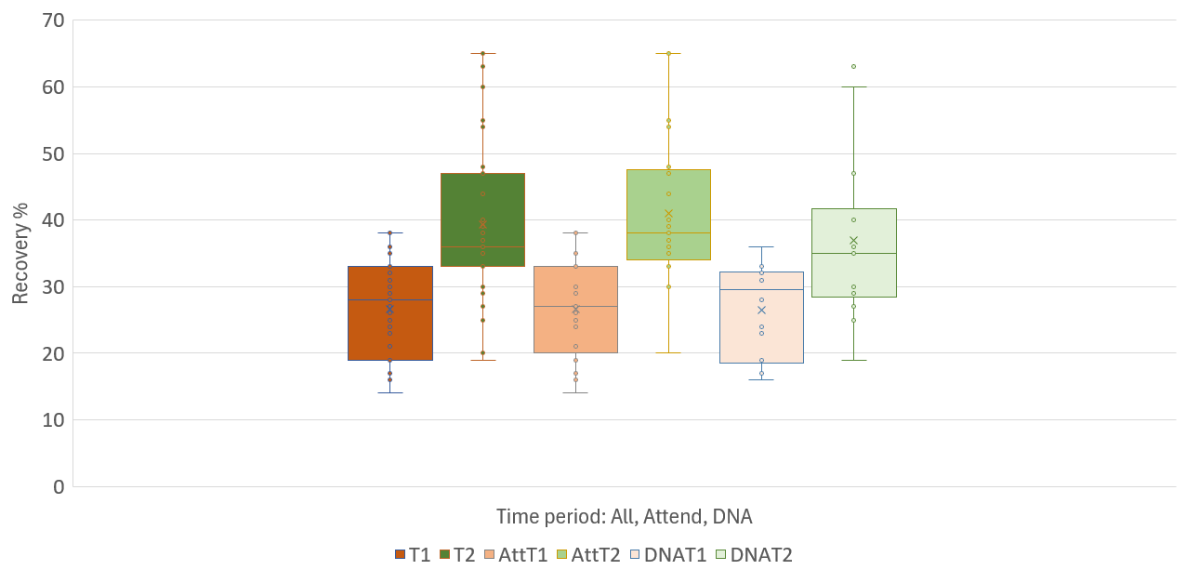
Low performing staff: recovery by attendance at PFG
Notes:
All = all invited. ATTEND and DID NOT ATTEND (but still flagged)
Despite the apparent remaining unwarranted variation, there appears to be an overall and impressive positive improvement for staff invited to the PFG for their service. Is there any evidence that attendance at the PFG added any increased improvement?

Slide 27
  What do you want?
  Current situation?
Goal
Reality
The PFG’s aimed to reflect on the gap between the goal of recovery and our reality and to generate options to close that gap.
Will do
Options
  What will you do?
  What could you do?
Notes:
GROW model as a means of engaging and inspiring shared purpose.

Slide 28
Method
Recovery data for all substantive Step 3 practitioners were extracted for two periods: Time 1 (Feb 2023–Jan 2024) and Time 2 (Sept 2024–Aug 2025). Interventions included:
Practitioner Dashboard: Implemented March 2024, providing individualized performance metrics.
Practitioner Focus Groups: Conducted July–Aug 2024, using the GROW model to explore reasons for variation and generate improvement strategies.

Slide 29
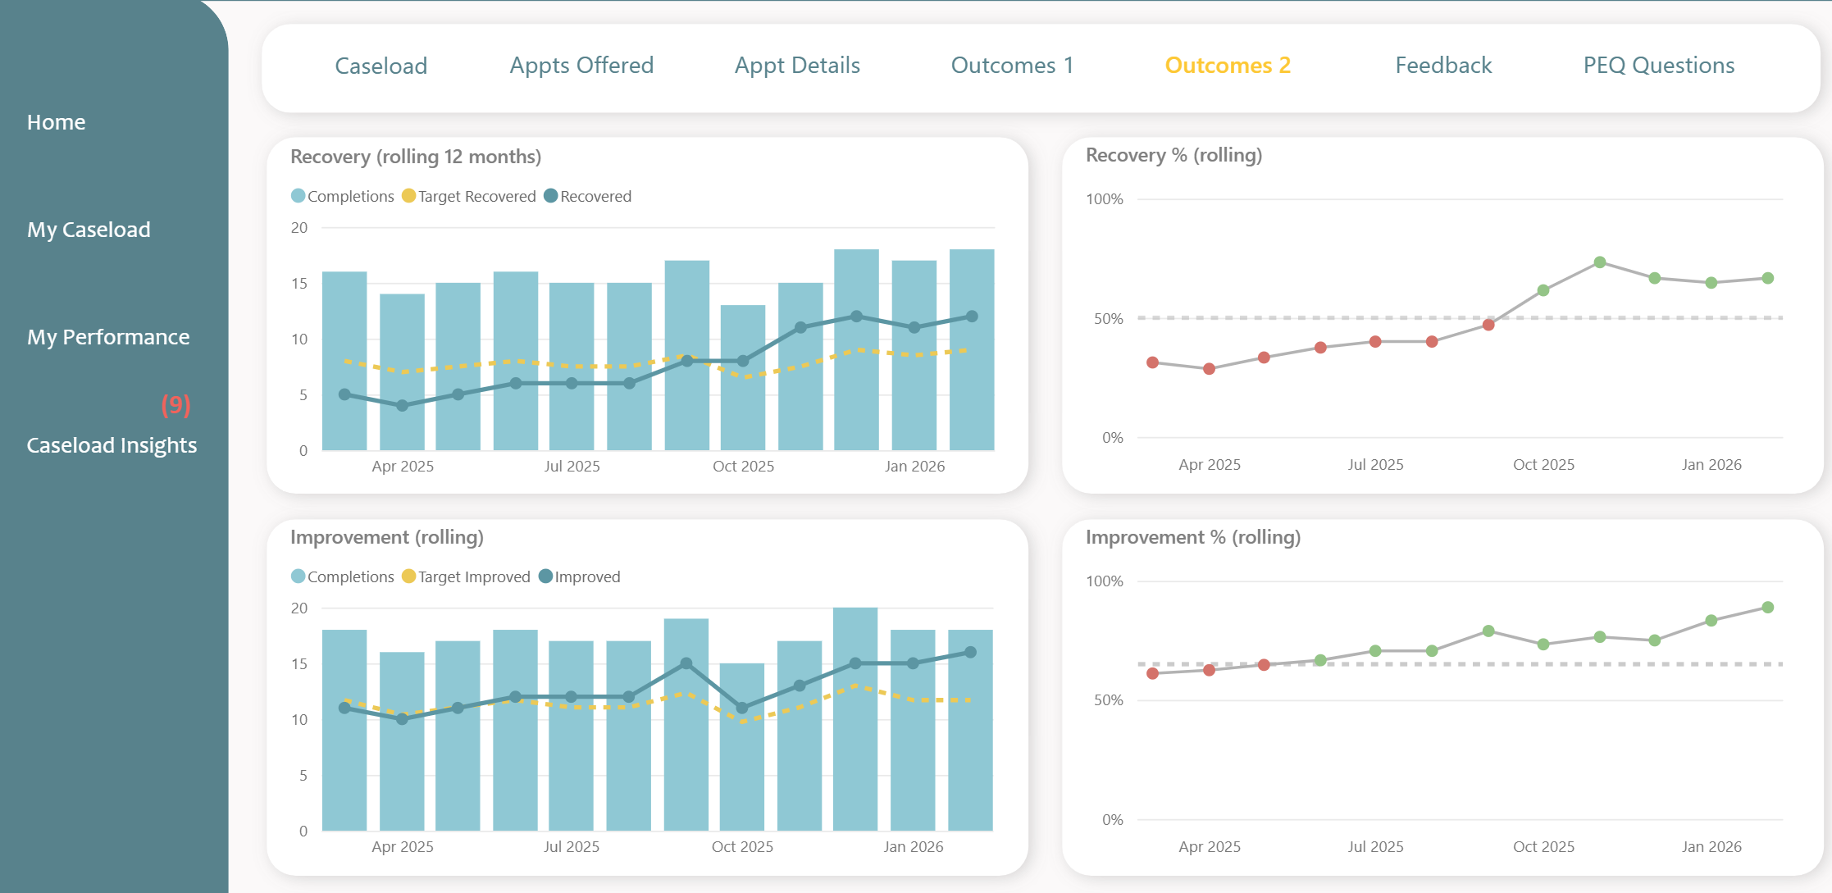
Practitioner Dashboard
Notes:
An example of one CBT from Service 6.

Slide 30
Practitoner Focus Groups (PFG)
In essence, the PFGs aimed to make explicit the current situation. Ensure practitioners had the opportunity to reflect upon, explore and discuss in the round, their views on contributory factors, and where appropriate, shift external attributions to internal attributions highlighting solutions which we could do something about. Promoting self efficacy and approach coping.

Slide 31
PFG: Examples of attributions for recovery variation between practitioners drawing from same waiting list
Internal attributions | External attributions
“Some practitioners are more skilled in adapting their communication and interaction styles to fit the specific needs and backgrounds of their clients, which can significantly enhance engagement and recovery outcomes.” “Is there an emphasis on discussion of psychometric measures with clients, to better understand how this can help and whether it is as collaborative and meaningful as it could be.” | “I don't think practitioners recovery rates should be being compared, we are a team.” “There are factors affecting recovery that are not being taken into account.” “Are the targets for recovery realistic how are these targets set?” “Is recovery a fair reflection on whether or not a client has benefitted from therapy?” “The gatekeeping is not as good as it could be, we see clients that are not suitable for the service.” “Which clients end up on your caseload and the level of complexity and other factors such as neurodiversity.”
Notes:
We were interested to see if there was any difference between high performing and low performing staff; there was a trend but no significant difference.
In fact only significant difference between the two groups (training, profession, years of experience etc) was in the proportion who chose to attend the PFGs (invited as a representative of their service not as a Low or High performing member of staff).
21 attended (35 invited) LO 60% attended
37 attended (42 invited) HO 88% attended
General engagement with work and motivation to make a difference?

Slide 32
  What do you want?
  Current situation?
Goal
Reality
What are our options to help close the gap between practitioners with high recovery rates and those with low recovery rates?
Will do
Options
  What will you do?
  What could you do?

Slide 34
PFG: Examples of attributions for recovery variation between practitioners drawing from same waiting list
 | Internal | External
Reasons given | Experience & modality | Service issues
 | Interpersonal skill & adaptability | Client complexity
Examples | “I feel one of the reasons why some practitioners have lower recovery rates is because they are only trained in one modality.” “Some are more skilled in adapting their communication and interaction styles to fit the specific needs and backgrounds of their clients which can enhance engagement and recovery outcomes.” | “As a service, the gatekeeping is not as good as it could be.” “I have a large number of clients with LTC which are severe and unlikely to meet recovery due to complex social issues.”
Notes:
We were interested to see if there was any difference between high performing and low performing staff; there was a trend but no significant difference.
In fact only significant difference between the two groups (training, profession, years of experience etc) was in the proportion who chose to attend the PFGs (invited as a representative of their service not as a Low or High performing member of staff).
21 attended (35 invited) LO 60% attended
37 attended (42 invited) HO 88% attended
General engagement with work and motivation to make a difference?

Slide 35
What are our options to help close the gap between practitioners with high recovery rates and those with low recovery rates?
Question | Most said…
Accept marked variation and not intervene… | Disagree
Leave to be discussed 1-1 in line management… | Not sure
Establish peer support groups for staff with low recovery… | Not Sure
Establish consultation groups led by a clinical leader… | Not sure
Arrange additional clinical supervision… | Agree
Deliver training on collaborative use of questionnaire scores… | Agree

Slide 36
PFG: Examples of solutions for variation between practitioners drawing from same waiting list
 | Internal | External
Solutions suggested | Personal reflection & Adaptability | Service delivery &workload management
 | Therapeutic skills development | Training & supervision
Examples | “Listening to feedback from clients and colleagues and integrating it into my practice, has been key to improving my effectiveness as a therapist.” “We need to ensure that measures are not just completed as a formality but are integrated meaningfully into therapy, making them a collaborative pat of the process .” | “We need to improve the assessment process and decision-making re client allocation.” “Having a competent knowledgeable supervisor is crucial. This support is essential to good decision-making, good outcomes, and practitioner development.”
Notes:
We were interested to see if there was any difference between high performing and low performing staff; there was a trend but no significant difference.
In fact only significant difference between the two groups (training, profession, years of experience etc) was in the proportion who chose to attend the PFGs (invited as a representative of their service not as a Low or High performing member of staff).
21 attended (35 invited) LO 60% attended
37 attended (42 invited) HO 88% attended
General engagement with work and motivation to make a difference?

Slide 37
What helped me improve my clinical effectiveness?
Notes:
Ten staff from Group 1 who had a recovery rate improved by >15% were contacted, congratulated and asked to feedback anything they thought had helped to contribute to this remarkable improvement.
Most thought the improvements were the result of several changes in their practice. The following themes were shared.

Slide 38
Summary: can we reduce unwarranted variation in recovery between staff?
Yes. At least, we can say a difference was made or at least observed.
Staff engaged staff in the process
This was not a controlled study, or even a thorough test of specific methods, we can’t say exactly what made the difference
Holy Grail found? No. Maybe hacked out a more direct path
There were still 27 staff (9.8%) with very low recovery
Best considered a clinical process for managing variation, that seemed acceptable to staff and is explicit enough to replicate and generalise
Addresses an issue central to our purpose
Notes:
What can we say?
What Roger Paxton used to call short and dirty research.

Slide 39
Thank you for listening. Please feel free to get in touch:
Dale.Huey@gmmh.nhs.uk

Slide 40



PCE-CfD DEMENTIA COUNSELLING GROUP
PILOT EVALUATION

Slide 41

Pilot Development
The local NHS ICB (Integrated Care Board) were interested in supporting a collaborative treatment pathway between Alzheimer's Society and Talking Therapies.
One of the aims of the LSCFT TT Older Adult Champion group was to explore ways to increase the prevalence of over 65yrs accessing talking therapies in line with the recommendations set out in the NHS Talking Therapies Positive Practice Guide: Older People (2024). Therefore, this group was used as the forum to develop the Pilot.
Notes:
Older People Positive Practice Guide - May 2021 - NHS Talking Therapies, for Anxiety and Depression - FutureNHS Collaboration Platform

Slide 42

Rationale for Group Intervention
BACP (British Association for Counselling and Psychotherapy) Guidance
The BACP states that the aim of counselling is to provide an opportunity for a person to tell their story, help them to understand themselves better and make positive changes in their life.
NHS Talking Therapies Positive Practice Guide: Older People states:
‘Older people experiencing mild cognitive impairment (MCI) and those caring for them should not experience barriers to accessing Talking Therapies services’
‘Services should develop clear pathways with other services such as Age UK and the Alzheimer’s Society, to share knowledge and best practice. Therapy should not be denied to an older person because they are living with dementia provided they meet the criteria for a Talking Therapy intervention.

Slide 43
Rationale for Group Intervention
PCE-CfD Theory
Counselling for Depression (CfD) is a specific form of psychological therapy, based on a framework of evidence-based competences. It is a step 3 intervention and recommended for persistent subthreshold depressive symptoms or mild to moderate depression that has not responded to a low-intensity intervention (NICE, 2011).
Group Counselling Theory
Group interventions can provide a safe space to talk about experiences and be supported by others. It can help exploration and understanding of feelings, gain new insights and perspectives, and connect with others who are also experiencing similar challenges. The group setting helps people to better understand themselves, share experiences and relate to others. This increases self-awareness, builds confidence and leads to a sense of being less isolated.

Slide 44
Rationale for Group Intervention
Theory for working with Dementia client
Kitwood, (1997) described the psychosocial needs of people living with dementia.
Norberg, (2019) described importance for identity; people living with dementia may rely on those around them to support their sense of self.
BACP (British Association for Counselling and Psychotherapy): “that the aim of counselling is to provide an opportunity for a person to tell their story, help them to understand themselves better and make positive changes in their life”
NHS Talking Therapies Positive Practice Guide: Older People, (2024): ‘Older people experiencing mild cognitive impairment (MCI) and those caring for them should not experience barriers to accessing Talking Therapies services’
NICE Guidance: NICE guideline [NG97]Published: 20 June 2018. Depression and anxiety - 1.7.11 ‘For people living with mild to moderate dementia who have mild to moderate depression and/or anxiety, consider psychological treatments’

Slide 45
Collaboration
Talking Therapies Clinical Leads
Services Manager Alzheimer’s Society Central locality
Programme Manager Mental Health Transformation Team ICB
Discussed psychological benefits of a support group for people who are suffering with early stage dementia
Agreed the group would be aimed at those with mild symptoms of dementia (early stages) and limited cognitive impairment
The group would initially be piloted in Preston
Tasked the Older Adult Champion Group to take this forward

Slide 46
Phase 1 - Older Adults Champion Group
Older Adults Champion (OAC) meetings
Researched resources & guidelines for supporting people with dementia
Themes identified: loss; fear; impact on relationships & family dynamics; adjustment, unable to perform tasks as used to, coming to terms with changes, sense of self -adapting to different roles within family/work; existential- identity, wider society, loss of independence, practical losses (driving); depression symptoms; grief
Theoretical model agreed most appropriate -PCE-CfD Counselling approach
Notes:
BACP, BABCP, A Society ,

Slide 47
Phase 2 – Clinical Group Development
Sub group planning meetings:
  Explored the therapeutic themes/goals, resources, inclusion/exclusion criteria, course length, session duration, number of participants, capturing outcomes, managing risk- PHQ9/GAD7 measures: inclusion/exclusion/risk/ recovery progress/impact of group/psychological benefits
Assessment, suitability, referral process:
TT & AS developed a promotional information sheet & group therapy agreement
AS screen potential clients- cognitive functioning/ability to engage
AS refer to TT for suitability assessments (presentation; common mental health problems; risk)
Clients registered & added onto IAPTus group pathway

Slide 48
Phase 3 - Group Formulation
Using a PCE-CfD Counselling approach
Co-facilitated – 2 counsellors (TT) & Alzheimer’s Society Advisor (AS)
6 session model
2 hours clinical group time
Up to 10 participants
Face to Face method of delivery
Time before and after for carers- contact support from TT & AS

Slide 49


Group Weekly Planner
Week | Group Theme | Tom Kitwood Theme (Dementia Care Mapping) | Key Ideas | Interventions | Handouts
1 | Intro/ Orientation | Love/ UPR | contracting/ MDS/ ‘telling my story’ | Flashcards/ emotion wheel – to help name feelings and emotions | weekly journal to capture reflections from each group session
2 | Family Dynamics | Attachment/ comfort/ inclusion | changes/ adapting to different roles within family/ society | Focussing/grounding/breathing techniques – connecting with the body | Sleep and self -soothing handouts
3 | Loss | Comfort/ identity/ occupation | loss of relationships/ loss of purpose/ meaning (work?) | Use of Waterfall of grief image
4 | Independence | Occupation/ identity | practical losses such as driving licence/ financial | Self-responsibility has existential meaning | Use of a sensory mood basket or box
5 | The self-identity | Identity/ occupation | Impact on Sense of self/ loss of self. ‘who am I?’ ‘Who will I become?’ | The person is more than her present condition
6 | The future and endings | Inclusion | What does the future hold? Saying goodbye
Notes:
Tom Kitwood (1997) described the psychosocial needs of people living with dementia. These psychosocial needs describe the support that eople living with dementia need to uphold their personhood. Kitwood illustrated these psychological needs as a flower with five overlapping petals to represent five needs. The central need of Love illustrates unconditional positive regard and acceptance – crucial to maintaining the personhood of people living with dementia.
• Attachment indicates the people and things, which we are close to or wish to be closer too. It is also aligned to feelings of trust and security, with people feeling the need to turn to their attachments during periods of crisis or anxiety. People with dementia can have their attachment needs threatened when entering care settings as they are away from home and may not have regular contact with familiar people. Kitwood believed that “Without the reassurance that attachments provide it is difficult for any person, of whatever age, to function well. There is every reason to suppose that the need for attachment remains when a person has dementia; indeed it may be as strong as in early childhood”.
• Comfort is about the need for psychological warmth. When people feel psychologically comforted, they will feel less anxious and safe in their environment. The need for comfort can be provided through physical means, which could be as simple as giving the person a hug or holding their hand. For others, soothing words and actions, which display kindness towards the person, will be a source of comfort.
• Identity is about how the person thinks and feels about themselves. ‘As humans, we have a sense of self, and at best, we are proud of our abilities and feel respected by other persons’ (Norberg, 2019). People living with dementia may rely on those around them to support their sense of self. For identity to be upheld, the life story of the person must be maintained, either by themselves or by people supporting the person living with dementia.
• Occupation relates to more than a job role but indicates a sense that one’s actions are purposeful and have meaning to others. Occupation and activity are essential for all human beings and this need does not diminish due to age or cognitive decline. People living with dementia can be at risk in care settings if caregivers have a ‘can’t do’ attitude, which will often lead to the person becoming disengaged, as they are denied activities or offered activities without purpose.
• Inclusion is about being part of something bigger than oneself. The risk of social isolation for people living with dementia is considerable. If the person is made to feel excluded, they are less likely to attempt this inclusion themselves and risk isolation, which may lead to depression and further cognitive decline. Recognising the need for people living with dementia to be part of the social world is crucial in meeting the need for inclusion.

Slide 50
Group Themes
Similar fears – impact upon sense of identity – concerns over the progression of the disease
Similar ways of dealing with symptoms of memory loss – primarily engaging in the here and now
Similar experience of diminished autonomy
Similar experience of feelings surrounding loss and grief
Similar experiences of diagnosis (not enough support)
Similar experiences of symptoms with lack of recall impacting engagement with others - (e.g. - forgetting names of foods/forgetting events – preventing ability to engage with others in present moment)
Initially not noticing symptoms themselves
Identity and occupation - Changes in ones perceived sense of purpose and meaning to others- feeling unneeded

Slide 51
Data / Outcomes

Slide 52
Quantitative Data- MDS
Data was collected at the beginning/middle/end of the group
The themes of each session were directly relatable to the MDS
We collected a lot of positive qualitative data regarding themes
Recovery 4/5 – 80%
Reliable Recovery 5/5 – 100%
Reliable Improvement 5/5 – 100%
W&SAS- Overall there was a downward shift

Slide 53
Quantitative Data- MDS for
Depression & Anxiety scores
CLIENT | ATTENDANCE | PHQ FIRST | PHQ FINAL | PHQ-9 | GAD FIRST | GAD FINAL
A | 1/6 | 11 | - | 0 | 9 | -
B | 4/6 | 4 | 3 | 0 | 1 | 5
C | 6/6 | 10 | 4 | 0 | 5 | 3
D | 5/6 | 13 | 3 | 0 | 12 | 3
E | 5/6 | 13 | 0 | 0 | 3 | 1
F | 4/6 | 13 | 6 | 1 | 11 | 9
G | 1/6 | 18 | - | 1 | 15 | -

Slide 54
Qualitative Data
Valuing the group setting – voicing their willingness and commitment to attend each week
Safety in group; not judged, accepting of feelings, encouraged one another
Felt heard, able to have a voice, talk freely
Valued sharing experiences, understanding, empathy
Honest about feelings without need to hide from or protect others
Valued insights into how others cope/manage
Feeling less alone with problems, increase hope that can still live well
Benefit from social contact/connection how this can be sought in other areas. Gratitude for support from family & services
Sharing grief and loss experiences normalising/validating
Exploration of self-identity, acknowledge person beyond diagnosis
Notes:
Assessment checklist/TT Decision Tree
Inclusion criteria – Early stage of dementia (ability to engage in group therapy)/symptoms of depression/willing to engage in the therapeutic process/low risk/comfortable in group setting/commitment to attend weekly.
Exclusion criteria – case-ness/risk – in alignment with SOP/advanced dementia/unable to commit without carer present.

Slide 55
Client Reflections
“ come into this group feeling very nervous but everybody made me feel a lot better and it was helpful”
“welcoming group and welcoing counsellors, good first impression”
“looking forward to this improving my mental health, caring environment, made to feel very welcome”
“very interesting session, everyone contributed, worth doing”
“ the time flew by, very interesting conversations, very informative”
“made me consider my feelings thoroughly, felt very comfortable”
“very thought provoking, helpful”
“very enjoyable session nice people”
“ its been helpful today, encouraging, shared worries about the future”
“validated own experience – where I am on my journey”
“ much encouraged and feeling better now I have been here”

Slide 56
Client Reflections
“ very helpful, nice to be able to discuss feelings with someone other than family who don’t always understand”
“nice to be able to explain my feelings to someone”
“appreciated having a phone number for services to call when feeling really down so I don’t have to bother family and can speak freely”
“ helped me understand loss of independence”
“ very sorry the group meetings have finished”
“it was a very well run group, very helpful in my mental struggles”
“sad that the sessions are finishing, I really looked forward to coming”
“ I have been very happy to attend this group, for the future I don’t know, but for now I will try to make my life better”
“Learned I just want to be happy and enjoy my life and how I am very lucky to have my wife and support”

Slide 57
What went well?
Appropriate focus/themes/weekly plan
Client engagement, willingness, commitment
Themes weaved in and out so not totally contained within each session but this felt appropriate and natural
The structure was a good scaffold to the work but flexible enough to enable a flow. Attempting to stick too rigidly to the themes would have interrupted the process.
30min before and after the group to settle and discuss with carers/ answer any queries or concerns after the sessions. Also needing to ensure clients were escorted to their transport after the session where needed

Slide 58

What would we change?
More time to recruit participants
8 week lead time to allow for referrals in and the telephone screening appointments to take place
Last screening to take place no later than 7 days prior to the group starting
Widen the professional referral route to other sources e.g. Dementia Nurses; AGE UK; Memory Assessment Unit
Not having AS advisor in the sessions to maintain therapeutic focus. Part of contracting would be our ability to share information with AS when the need arises for the benefit of the person

Slide 59


Benefits to Clients
Therapeutic space/support for people recently diagnosed with dementia
Opportunity to share their story/experience/explore feelings
Normalising, validating, feel less isolated/alone
Peer Support-enabled connection:
  similar impact upon sense of identity – concerns over the progression of the disease; fears/experiences
  valued sharing experiences, understanding, empathy
  honest about feelings without need to hide from or protect others
  valued insights into how others cope/manage
  feeling less alone with problems, increase hope that can still live well
  benefit from social contact/connection how this can be sought in other areas

Slide 60

Benefits to Clients
Reminds the older person they are still functioning and valued and important individual in their relationships with friends and family.
Provides space for exploring personal experiences of the individuals diagnosis which can sometimes involve a grieving process- both for the loss they experience as a result of dementia (memory loss) and for the loss of a perceived future they had anticipated without dementia
Exploring the recognition of loss; adapting to different roles in family/society
Psychosocial needs- support people living with dementia to uphold their personhood

Slide 61
Benefits to the service
Increase prevalence in line with the Older Adults Best Practice Guide 2024 for working with this particular age group as many people diagnosed with dementia are older adults
Increased recovery rates demonstrating efficacy of the group
Developing referral pathways; partnership working; collaborations
Addressing unmet need (no other space for therapeutic/psychological support)
Meeting aims of the service for equality, diversity and accessibility

Slide 62
Practical/ Operational Considerations
Step 3 clinicians time – admin, assessments, resources, travel, reporting
Prep time for printing resources
Time to set up the room
Refreshments - cost
Name cards, help with bonding
Sign in sheet with emergency number if any problems
Folder for each participant, resources/handouts
Time to talk with family/carers before after

Slide 63
6 week follow up review session
Client reflections since group finished
Insights/Themes
maintaining social connections/activities/routines/focus on the present/gratitude.
Reflections that the group provided a safe, non-judgmental space allowing freedom to express feelings regarding dementia.
A real acknowledgment valued the therapeutic focus of the group – as other social activities do not focus upon feelings surrounding diagnosis/lived experience of dementia.
Feedback received regarding how well group was received. All very keen to return today and showed a willingness to provide feedback top support further groups.
Consensus of real benefits of attending the group and wanting others with similar challenges to benefit also.

Slide 64
6 week follow up review session
Counsellor reflections from the follow up:
Review allowed reinforcement of individual identities/personal qualities/meaning and purpose.
Reinforced connection and understanding with others/sense of belonging.
Allowed for any risk to be explored- no concerns were identified regarding risk to self/others, maintaining since group.
Enabled discussion on maintaining focus upon what is helpful in day-to-day life – social connections/meaningful activities.
Further opportunity to promote ongoing support – signposting to talking therapies/Alzheimer’s Society support groups/dementia café and GP.

Slide 65

Thank You

Slide 66
Workplans in Talking Therapies: SPWP case study
Christina Fitzgerald (Consultant Clinical Psychologist/Clinical Lead) and Elspeth Ward (Supervision Lead) Mersey Care NHS Foundation Trust.

Slide 67
Agenda for today’s session
To look at job planning guidance from the BPS
To think about their applicability to other Psychological Professions.
To describe how these were applied to a group of staff in a Talking Therapies Service.
Reflections on this process.
Questions/comments/thoughts.

Slide 68
British Psychological Society guidance
The British Psychological Society produced Job Planning Guidance for Practitioner Psychologists updated in November 2023.
This guidance can be usefully used for our wider Psychological Professional workforce job planning as many of the same principles and considerations apply.
A job plan is a prospective, professional agreement that sets out the duties, responsibilities, accountabilities and objectives of the practitioner and the support and resources provided by the employer for the coming year (BPS 2023)
Notes:
Job planning is important in helping services to effectively deliver high quality outcomes for service users and allowing individual staff to be clear about the activities required to deliver those outcomes. Job planning processes are now widely used and recommended in the NHS and sets out the individuals targets and objectives for the coming year.

Slide 69
Collaboration is key.
A job plan should provide opportunities to develop both personally and professionally as well as aligning with the objectives of the organisation and the team.
Allows space for innovation and driving quality improvement for our patients.
Collaborating on a job plan needs to be meaningful for the individual in the context of the workplace that they in.
Supports monitoring and review of an individual employee’s work over the course of that year, including any support the employer will provide to enable the employee to achieve their objectives.

Slide 70
BPS outlines 10 underlying good job planning processes.
Ensuring that a job is deliverable and sustainable, with manageable workloads, sufficient resources, and support, and is within the competencies of the individual member of staff.
Ensuring that sufficient time is available to allow the staff member to carry out their role in a safe manner and to a high standard.
Ensuring that the job planning process is incorporated into the staff member’s appraisal process.
Making clear how the individual can contribute to the purpose/aims of the service.
Providing management recognition and endorsement of the range of activities required to carry out the job and maintain professional competence.
Taking account of issues of clinical governance in delivering the work including management and supervision.
Contributing to staff satisfaction and organisational effectiveness.
Enhancing the wellbeing and retention of staff.
Enhancing team working and service innovation.
Recognising and providing time and resources for supportive professional activities, including continued professional development, which are essential to the delivery of safe and effective services.

Slide 71
Working Time
For a full-time member of staff there are 37.5 hours available each week.
This work is normally carried out over 10 sessions of 3.75 hours.
For part-time staff these hours and sessions are calculated on a pro rata basis.
The number of weeks to be worked over the course of a year will take into account annual leave arrangements.

Slide 72
Job plan development
Direct clinical care; including direct clinical work (LIT and HIT)
Leadership, Governance and Management of Services and Staff
Teaching Training and Supervision
Research, Service Evaluation, Quality Improvement Activities and Audit
Supportive Professional Activities such as CPD
A job plan is developed by the member of staff and their line manager and/or supervisor and recognises the balance of activities will depend on the staff members role within the organisation. It will align to their yearly appraisal and career aspirations.
Notes:
The BPS sets out different categories of work divided into Direct Clinical work and Supportive Professional Activities which would include things like CPD, special interest groups/Champion role related work etc.

Slide 73
Talking Therapies Manual Guidance
Productivity aspirations should be based on workloads that are consistent with professional and ethical guidelines for sustainable quality of care.
Variety in role is important, allowing time for special interest Champion roles and opportunities for progression at both step 2 and step 3.
Ongoing training and CPD is essential.
A meaningful job plan will incorporate all of the above and serve as a blueprint to guide the working week.
We worked on creating a shared job plan template for our SPWP’s in Mersey Care and here’s how it went.

Slide 74

Senior Psychological Wellbeing Practitioner (SPWP) Job Plans – Case Example
ELSPETH WARD | Supervision Lead

Slide 75

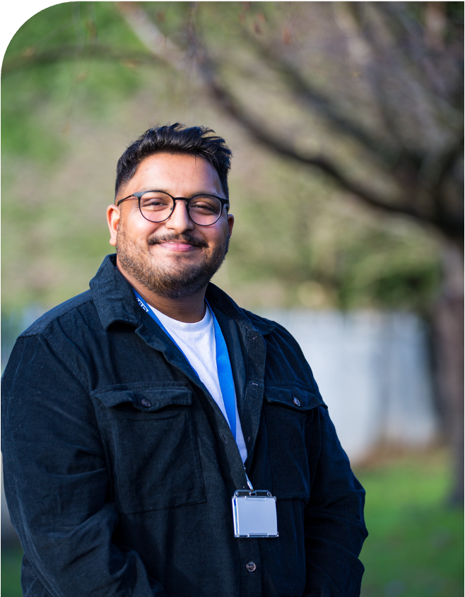
Context to Senior PWP Job Plan Project
6 Teams with 21 SPWPs
The SPWP role and remit:
‘Clinical Leadership of Step 2, at a day to day level’
Significant variation in current job plans
Need for standardisation and accountability
Notes:
Talk to scope of project

Slide 76



Our Talking Therapies Service
Scoping:
Senior PWP workforce and Clinical Team Managers
Engagement Meetings:
Team Canvas
Components Task
Standardisation of processes including one IAPTus system and other shared processes including care pathways and SOPs
Trust Merge
Bringing together four Talking Therapies Services
Feedback that there was not enough clinical oversight and consistency of step 2 work – increased capacity with a dedicated focus for step 2
Implementation of a shared but flexible job plan: recognition of the value of the workforce and the work they do; we want to ensure this work is recognised and celebrated
Notes:
Process of project

Slide 77
Taught CPD Programme
Examples from scoping
Involvement in planning and delivery
Adhoc Tasks
Confidence
Time consuming
Recovery work
The tasks:
Rota, Calls, ….
Team Requirements:
1% can be a few calls vs 100’s
Unclear

Slide 78

Engagement Meeting Feedback
Team Canvas:
COLLABOURATION, shared learning, clinical support of step 2 workforce, positive client outcomes, CMS/CSS, SUPPORT service delivery
Components Task – feedback on tasks and time, no significant changes
Overall positive response
Developing clear service wide expectations of role
Notes:
Two words stood out: SUPPORT and COLLABOURATION

Slide 79
PWP Supervision Considerations and Learning
Engagement Feedback Example
CMS:
Clear expectations of what is covered (refreshed contracts and
Proforma developed as a result)
+ 15 min additional time if group facilitator
CSS Topics expectations
Be clear, not just SPWP talking – skills, observing recordings
Developing shared resource bank through SPWP meetings

Slide 80
SPWP Job Plan Components
‘Clinical Leadership of Step 2, at a day to day level’
Core Components
(Every SPWP)
Clinic
Own CMS
Own Line Mgt
Own CSS
Own CPD
CMS of PWPs
CSS for PWPs
Observed Practice
Step 2 CPD
Meetings
Meta Supervision
Clinical Drop In
Nominated Core Components 2
(One Senior PWP within team who leads, with Deputy or additional time, as per Team need)
Trainee PWP support
SilverCloud
Courses
Recovery
Tasks that vary by Team, SPWP and time required
Ad Hoc Response Cover
Notes:
Concept
Flexibility - service/team needs – respond to these
Accountability – your responsibility to execute – oversight – consequence i.e. CMS – individuals not following attendance – you… Recovery: Liverpool reach/not reach recovery – calls – way conducted, recovery focus through CMS all the way through…. Band 6 Nurse runs a Ward!

Slide 81
SPWP Job Plan Example
 | Monday | Tuesday | Wednesday | Thursday | Friday
AM | Nominated Core Task Time: Recovery | Taught CPD: Attending/ Supporting delivery | 3x CLM inc Protect Prep Time inc. Step 2 Review Monitoring | 3x CLM inc Protect Prep Time inc. Step 2 Review Monitoring | Own 1:1 Clinic (1x Assessment 2x PWP 1:1, 1x cCBT review)
PM | CSS Group: Prep/Delivery Observed Practice of PWPs/Groups | Meetings Champion Role | Other Team specific identified task Own CMS/CSS (1hr a fortnight) | Adhoc Response Cover | Nominated Core Task Time: Courses
Notes:
EXAMPLE:
Core Components
2x Nominated Core Tasks
Other Team Specific Identified Tasks
Ad Hoc Response
Team X vs Team Y – mix based on need

Slide 82

Thank you
Any Questions?

Slide 83


BREAK

Slide 84

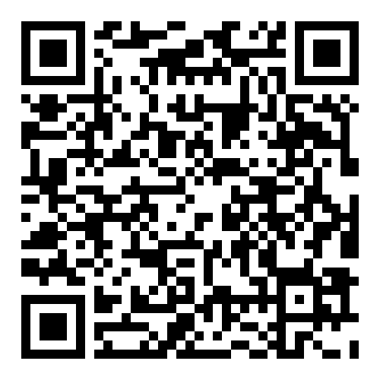
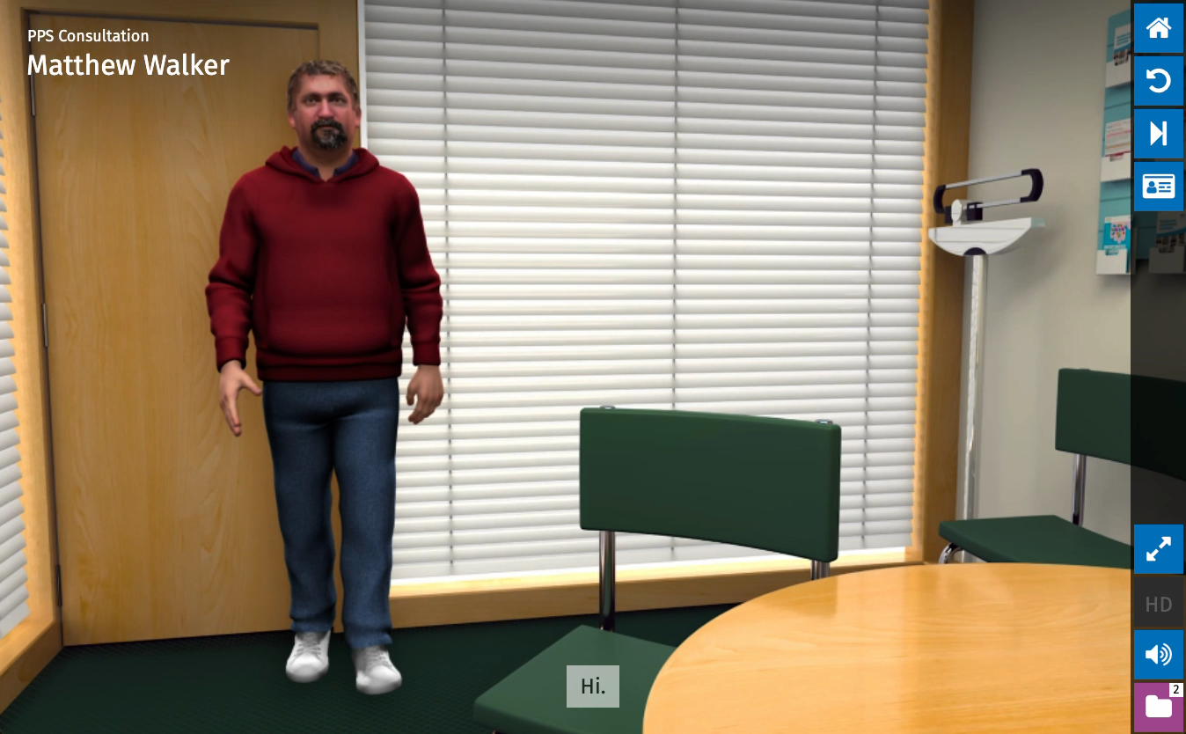


Emotionally Intelligent
Digital Pedagogy
The Potential for Virtual Patients in the Training of Psychological Wellbeing Practitioners
Dr Paul Thompson: paul.thompson@tees.ac.uk

Slide 85

Aims
Background to the Research
Theory & the EIDP Framework
Virtual Patient
Findings & Implications
Next steps

Slide 86

Background
Training Challenge
  PWP training is intensive, fast-paced, and highly applied
  Traditional experiential learning (role plays) cause many logistical issues yet are needed to support clinical development and are commonly the most anxiety provoking activity
    timing / chronotype / availability / confidence / receiving meaningful feedback (peer to peer)
  Alongside role plays, many of the skills associated with assessment are practiced with real patients
  There is a reliance on experiential learning to enable application of theory into practice
  More experiential learning = better application = more confident practitioners
  Logistical issues within clinical practice leads to different trainee experiences (Owen, 2020)
  Can lead to increased stress making trainees more susceptible to burnout (Owen, 2021)

Slide 87
Background
Research Motivation
  To help trainees not only to pass assessments, but to thrive in real clinical practice
  Increase experiential learning whilst reducing stress and anxiety associated with traditional role plays
  Content delivery and support wellbeing: they are not mutually exclusive
Aims
  Develop a method of increasing experiential learning activities without increasing lecturer or supervisor workloads
  To ensure that wellbeing was specifically integrated into teaching and learning
Different project – virtual patient for GPs led by Dr Philippa Bolton

Slide 88
Why Virtual Patients
Virtual simulations allow learners to
practise repeatedly on their own
explore different decisions without risk
reflect on consequences ‘in the moment’ as well as retrospectively
develop confidence alongside the usual teaching methods
No risk to real patients
Focusing on knowledge and skill development didn’t consider the wellbeing aspect

Slide 89
Theoretical Foundations
Educational Theory
  Social Constructivism – learning shaped by a social and cultural context (Vygotsky, 1978)
  Experiential Learning – learning through doing and reflection (Dewey, 1938, Kolb, 1984, Schon, 1991)
  Cognitive Load Theory – managing mental effort in learning (Sweller, 1988)
  Technology Acceptance Model – ensuring digital tools are perceived as useful and easy to use, supporting adoption (Davis, 1989)
Multimedia Learning Theory
  Cognitive Theory of Multimedia Learning (CTML) – people learn better from audio & visual providing they complement (Mayer, 2005)
  Cognitive Affective Theory of Learning with Media (CATLM) extends CTML by including the role of emotions, motivation, and metacognition (Moreno, 2006)
  Cognitive‑Affective‑Social Theory of Learning in Digital Environments (CASTLE) – uniting cognitive, affective, and social processes in learning (Schneider, et al., 2022)
Psychological Theory
  Psychological Capital – building hope, efficacy, resilience, and optimism (Luthans, et al., 2007)
  Emotional Intelligence – developing awareness, empathy, and regulation (Goleman, 1995)

Slide 90
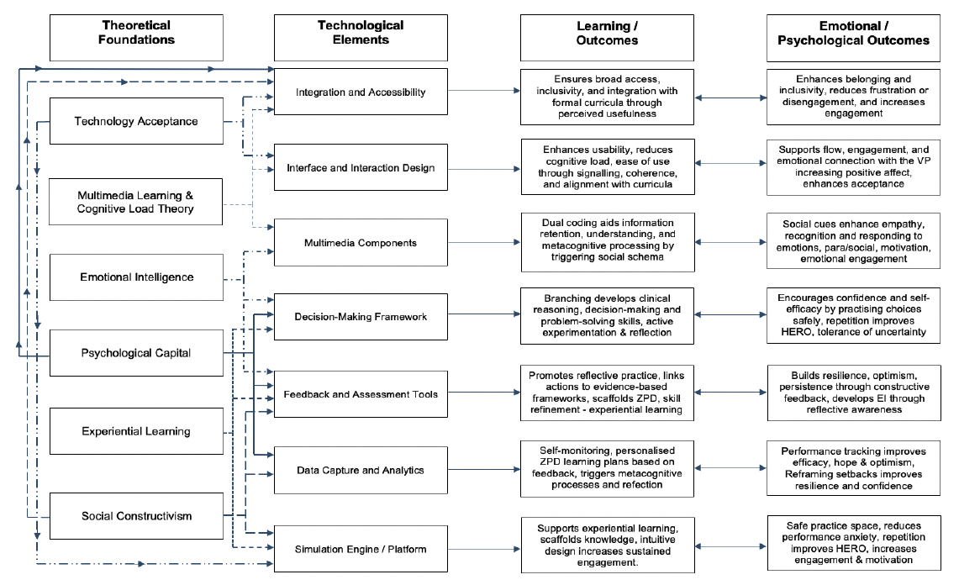

Slide 91

Virtual Patient Design
Pedagogical Foundations
  EIDP framework guided design
  Aligned with the national PWP curriculum
Design Features
  Scenario-based dialogue with branching pathways, simulating authentic client encounters
  Multimedia integration – text, audio, and video for realism and accessibility
  Feedback loops – verbal and text, RAG-coded feedback, and structures supervision discussions
  Affective features – decisions with consequences increases engagement
  Social features – anthropomorphic characteristics increase social schema

Slide 92
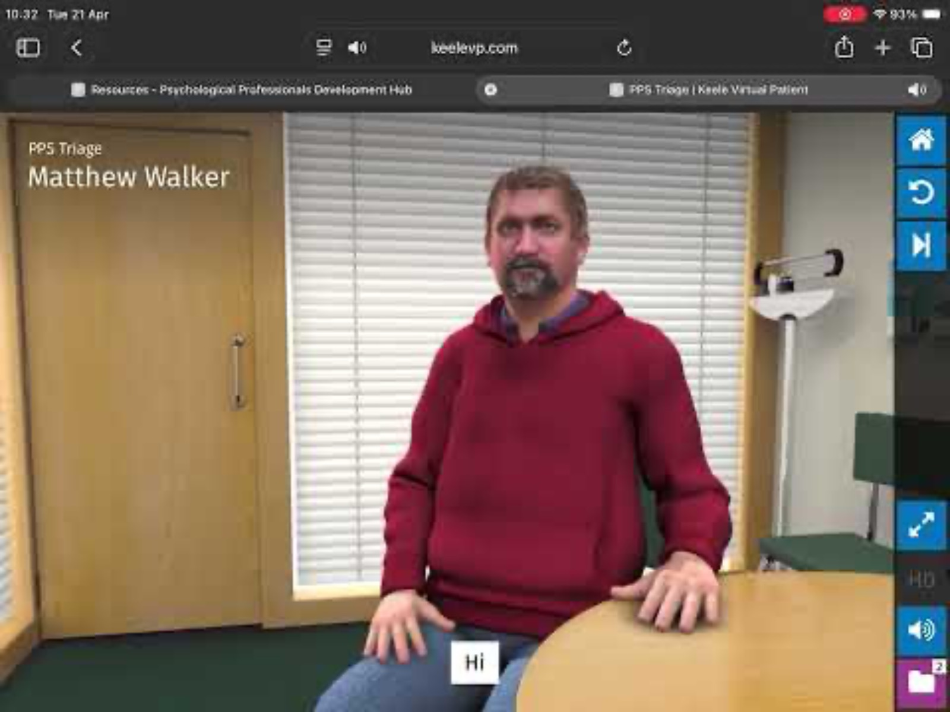
Virtual Patient: Introduction
Branched pathways over LLM

Slide 93
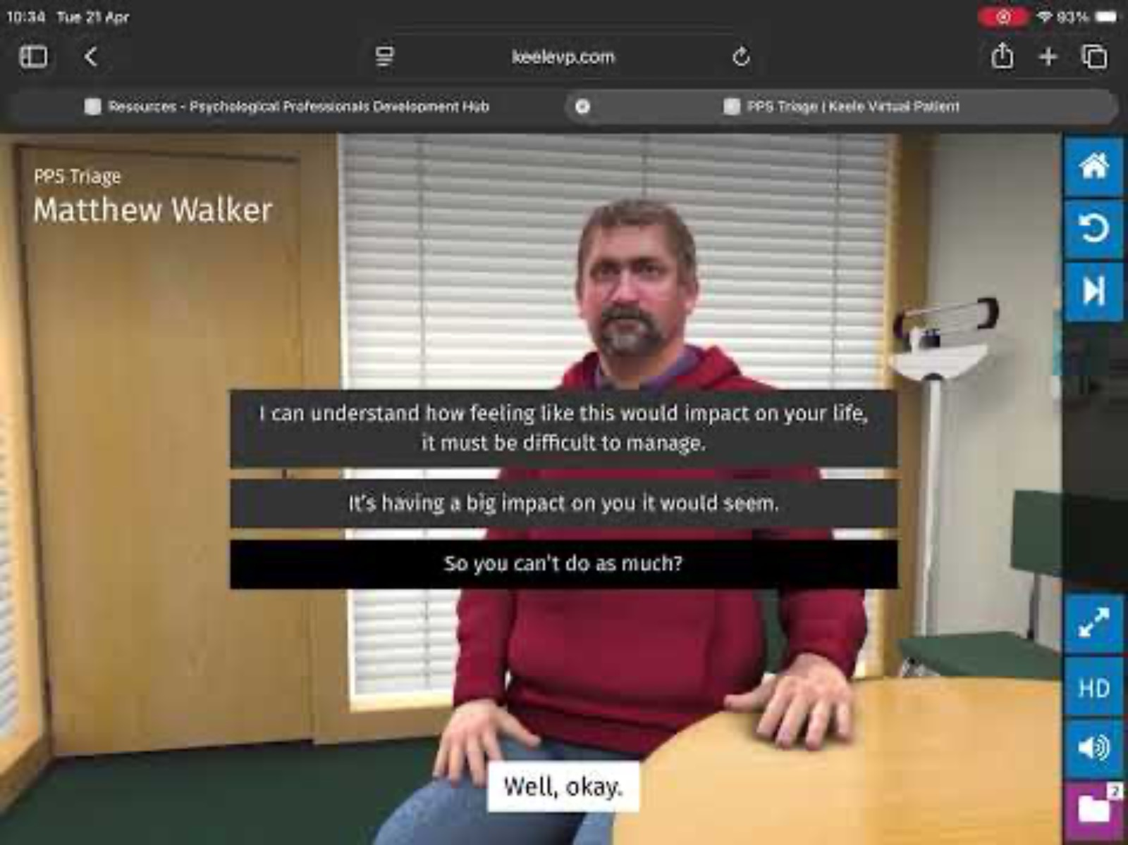
Virtual Patient: Consequences
Enabled reflection in action (Schon, 1983)

Slide 94
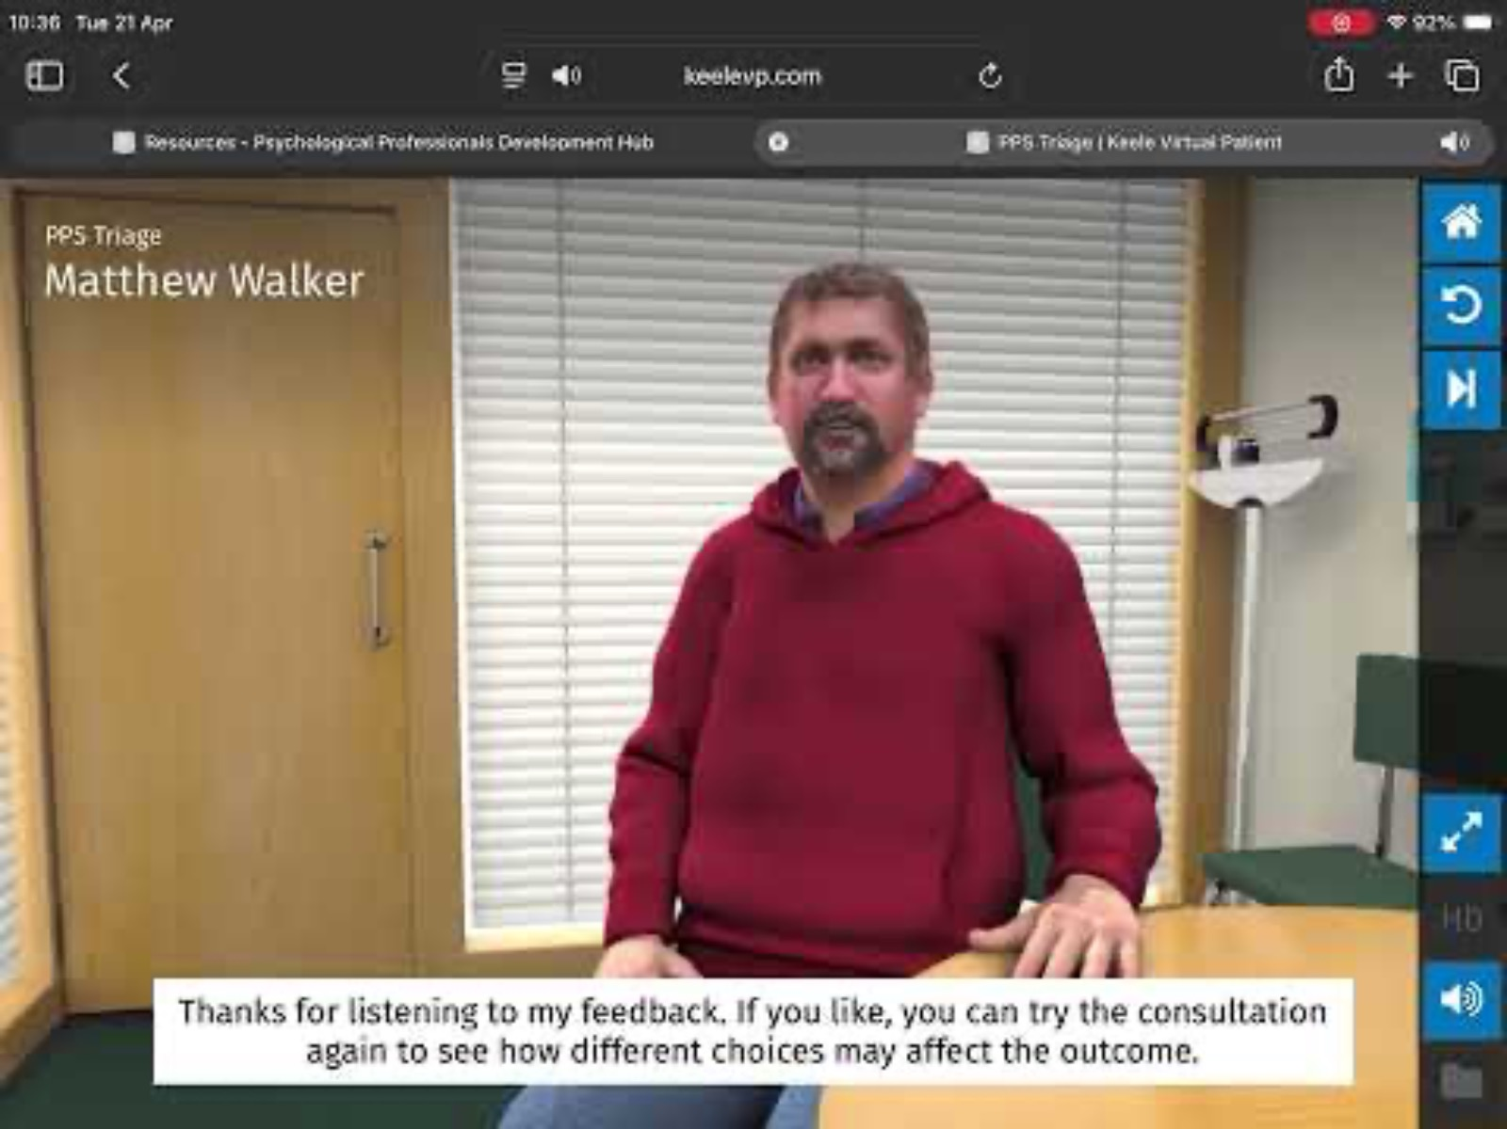
Virtual Patient: Feedback
Enabled reflection on action (Schon, 1983)

Slide 95

RESEACH DESIGN
Mixed methods, quasi experimental design. Two naturally occurring cohorts of trainee PWPs within the same HEI were involved. Cohort 1 followed the standard curriculum (control; n = 42) and Cohort 2, who started the course one year after Cohort 1, followed the same curriculum with the addition of engaging with optional VPs (intervention; n = 16). Both cohorts were measured at the beginning of the course and after their first assessment at week 7
Research Questions
  Engagement and Impact – Q1: How will the integration of virtual patients into the training of psychological wellbeing practitioners, when learning about brief mental health assessment, affect their learning experience?
  Positive Emotional and Psychological Resources - Q2: Does the integration of VPs into the training of PWPs lead to higher levels of positive emotional and psychological resources?
  Therapeutic Self Efficacy – Q3: Does the integration of virtual patients into the training of psychological wellbeing practitioners, when learning about brief mental health assessment, effect the development of therapeutic self-efficacy (TSE) in those who have been trained with traditional methods compared to those who have had access to a virtual patient?
  Cognitive Processes – Q4: Does learning with a virtual patient effect trainee PWPs learning processes when compared to trainees who were taught using traditional teaching methods?

Slide 96
Findings: Q1
Engagement and Impact
  75% of trainee PWPs engaged with the VP between 1 – 10 times
  Those engaged with the VP achieved statistically significant higher grades between cohorts by an average of 4.8 points (p = .03) as well as within cohorts by 4.88 points (not sig.). Av move from 50-59 bracket to 60-69 bracket.
  No difference in the reported amount of self-directed study time
  Participants who engaged with the VP reported it was perceived to be less difficult to learn about assessment (p = .05)
  Participants who engaged with the VP reported they used less mental effort to learn the assessment (p = .03)
  83% of trainees would recommend the VP (including those who didn’t use it?!)

Slide 97
Findings: Q1
Implications
  Good VP design improves engagement, accessibility, and ease of learning.
  VPs supported self-directed learning without increasing study hours, improving efficiency rather than workload.
  Lower perceived difficulty and mental effort suggest VPs reduce cognitive load and make complex learning more accessible.
  Immediate feedback strengthened reflection, learning consolidation, and clinical reasoning.
  VPs acted as a “virtual supervisor,” supporting independent practice within the Zone of Proximal Development.
  Higher OSCE performance suggests VPs improve both academic outcomes and practical clinical competence.
  More trainees achieved higher grade bands, indicating VPs may support skill acquisition quicker than traditional methods
  Repeated use increased perceived usefulness, showing VPs need sustained integration rather than one-off use.

Slide 98
Findings: Q2
Positive Emotional and Psychological Resources
  No difference in positive affect between those who used the VP and those who didn’t – both cohorts reported lower positive affect as the course progressed (non-VP -6.2 / VP -12.75)
  Those who used the VP had significantly lower negative affect
  Psychological Capital (Hope, Efficacy, Resilience, Optimism) was higher in those who used the VP and there was a negative correlation between NA and PsyCap (higher PsyCap = lower negativity) – not sig.

Slide 99
Findings: Q2
Implications
  VPs may support both clinical competence and Psychological Capital (hope, efficacy, resilience, optimism).
  VP users showed trends of increased PsyCap, suggesting VPs may help build early emotional resilience and confidence.
  Emotionally intelligent VP design may support self-awareness, empathy, emotional regulation, and reflective practice.
  Reduced positive affect across training highlights the need to protect trainee wellbeing alongside competence development.
  Lower negative affect and higher PsyCap may suggest VPs may provide an emotional buffering effect against stress.
  Emotional preparedness should be valued as highly as knowledge acquisition, making VPs dual-purpose tools for learning and wellbeing.

Slide 100
Findings Q3
  VPs did not significantly improve therapeutic self-efficacy (TSE), suggesting confidence may develop more slowly than knowledge or skills.
  Traditional training showed a small increase in TSE, while the VP group showed a slight decrease, though neither was significant.
  VPs may improve knowledge, reasoning, and emotional readiness before changes in therapeutic confidence become visible.
  Higher CASES scores were linked to better assessment grades, showing stronger TSE is associated with better clinical performance.
  Reduced TSE in the VP group may reflect greater self-awareness of clinical complexity rather than poorer learning as they performed better on the OSCE.
  VPs may act as a “reality check,” moving trainees from unconscious incompetence to conscious incompetence.
  Better OSCE performance despite lower TSE shows competence and confidence do not always develop at the same pace.
  Temporary dips in confidence after VP use may represent healthy self-assessment and professional growth rather than failure.

Slide 101
Findings Q4
  VPs reduced peripheral thinking and distraction, helping trainees stay focused on the learning task rather than self-conscious thoughts.
  Lower peripheral thinking suggests improved attention, concentration, and self-regulated learning.
  Higher lower-order thinking indicates stronger knowledge recall, recognition, and retrieval of symptoms and presentations.
  VPs supported the foundational stages of learning before progression to more complex reasoning and decision-making.
  Slightly higher middle-order thinking suggests improved comprehension and application of knowledge in realistic clinical contexts.
  Higher frequencies of higher-order thinking suggest VPs may support analysis, problem-solving, metacognition, and clinical reasoning.
  Reduced anxiety and nervousness in the VP group suggest emotionally safer learning environments improve engagement and emotional regulation.
  Emotional wellbeing and cognition are closely linked, showing positive psychological resources support stronger higher-order thinking.

Slide 102
Implications for Practice
Further research is needed due to sample size, however some of the recommendations were:
  VPs may strengthen Psychological Capital (hope, efficacy, resilience, optimism), supporting trainee wellbeing and potentially improving retention within NHS Talking Therapies services.
  Using VPs as “psychological vaccination” can help trainees build confidence and emotional resilience before live role plays or real patient contact, particularly for high-anxiety or performance-sensitive learners.
  VPs can reduce pressure on clinical supervisors by supplementing traditional role play, allowing supervision time to focus more on reflection, feedback, and clinical decision making rather than repeated rehearsal.
  VPs may help standardise experiential learning across services, reducing inequalities caused by inconsistent supervision, staffing shortages, or variable workplace support.
  Higher OSCE performance among VP users suggests VPs may accelerate safe skill acquisition and possible reduce the need for later remediation by supervisors.
  Because PWP cohorts are academically and professionally diverse, VPs offer flexible learning that supports both beginners needing repetition and advanced learners seeking deeper clinical reasoning.
  VPs could be used formatively to identify trainees who need additional academic, clinical, or emotional support early in training.
  Embedding VPs across both university teaching and clinical services may support a sustainable hybrid training model that improves workforce development without adding major pressure to already pressurised services.

Slide 103


Next Steps
EIDP Learning Framework
EIDP was used to inform the development of live and on demand learning at the PPDH
Virtual avatars are embedded into recordings (video and audio) to help guide & engage learners
Plan to develop the framework further across digital learning platforms

Slide 104
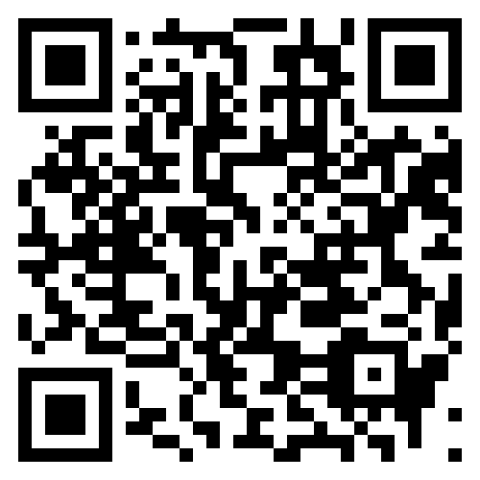
Next Steps
Virtual Patients
Development more diverse virtual patients
Development of intervention-based virtual patients
Trial emerging AI / virtual reality / augmented reality
Currently awaiting outcome of a grant to develop VPs to support teachers in Finland to deliver feedback to neurodiverse students (led by University of Helsinki, in collaboration with Research Council of Finland, Deakin University: Melbourne, Jönköping University: Sweden, & Teesside University: UK)
Scan to try the VPs
Credit: P. Boltons, P. Thompson and T. Pardoe
Scroll Down to VP Section

Slide 105
References
Davis, F. D. (1989). Perceived usefulness, perceived ease of use, and user acceptance of information technology. MIS Quarterly, 13(3), 319–340.
Dewey, J. (1938). Experience and Education. Pennsylvania State University.
Goleman, D. (1995). Emotional Intelligence: Why It Can Matter More Than IQ. New York: Bantam Books.
Kolb, D. A. (1984). Experiential Learning: Experience as the Source of Learning and Development. Englewood Cliffs, NJ: Prentice Hall.
Lent, R. W., Hill, C. E., & Hoffman, M. A. (2003). Development and validation of the Counselor Activity Self-Efficacy Scales. Journal of Counseling Psychology, 50(1), 97–108.
Luthans, F., Youssef, C. M., & Avolio, B. J. (2007). Psychological Capital: Developing the Human Competitive Edge. Oxford University Press.
Mayer, R. E. (2005). Cognitive Theory of Multimedia Learning. In R. E. Mayer (Ed.), The Cambridge Handbook of Multimedia Learning. Cambridge University Press.
Moreno, R. (2006). Does the modality principle hold for different media? A test of the method-affects-learning hypothesis: Modality principle. Journal of Computer Assisted Learning, 22(3), 149–158
Owen, J. (2020). The use of Practice-Based Learning Days on Psychological Wellbeing Practitioner training programmes: A Self-Determination Theory perspective. The Psychology Teaching Review, 26(2), 19–25.
Owen, J., Crouch-Read, L., Smith, M., & Fisher, P. (2021). Stress and burnout in Improving Access to Psychological Therapies (IAPT) trainees: A systematic review. The Cognitive Behaviour Therapist, 14, e20.
Schon, D. A. (1991). The reflective practitioner: How professionals think in action. Ashgate Publishing Ltd.
Schneider, S., Beege, M., Nebel, S., Schnaubert, L., & Rey, G. D. (2022). The Cognitive‑Affective‑Social Theory of Learning in Digital Environments (CASTLE). Educational Psychology Review, 34(1), 1–38.
Sweller, J. (1988). Cognitive Load During Problem Solving: Effects on Learning. Cognitive Science, 12, 257–285.
Vygotsky, L. S. (1978). Mind in Society: The Development of Higher Psychological Processes. Harvard University Press.
shweta.joel1@nhs.net

Slide 106





Co-Improving long term benefits for NHS Talking Therapies following Step 2 care for anxiety and/or depression
NHS Talking Therapies Leadership and Innovation Forum
23rd April 2026
Peter Bampton & Cintia Faija
CO-IMPROVE

Slide 107

Agenda
1- Research background: The Landscape & The Sustainability Gap
2- Meet the team
3- Project Overview
4- Findings
5- Limitations
6- Next Steps
7-Q&A
Patient and Public Involvement and Engagement (PPIE)
embedded throughout
Notes:
This project wasn't conducted in an ivory tower; it is a collaboration between clinicians who see these patients every day, academics specializing in long-term outcomes, and—most importantly—the patients themselves.

Slide 108

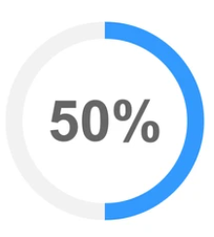


The Landscape
Global
Challenge
With over 580 million people affected by anxiety and depression globally, the pressure on healthcare systems is a "permanent state," not a temporary surge.
Economic Imperative
Beyond clinical morbidity, the impact on occupational functioning and physical health continues to be a primary driver of healthcare and economic burden.
NHS
Benchmark
Since 2008, NHS Talking Therapies has set the global gold standard for evidence-based care at scale.
In March 2025 50.6% of referrals moved to recovery highlighting the impact on short-term recovery.
Recovery
Rate
National data from March 2025, highlights we are successfully moving 50.6% of referrals to recovery.
This is a significant achievement in short-term clinical impact.
Notes:
Following info on NHS Benchmark: Since 2008, NHS Talking Therapies has remained the world’s most ambitious realization of evidence-based psychological intervention at scale. This ambition is reflected in our latest data: as of March 2025, we are achieving a 50.6% recovery rate—a massive operational feat.
However, the total scale of this prevalence means that 'short-term' success is only half the battle.T the very scale of our success brings a new strategic challenge into focus: the Sustainability Gap.

Slide 109
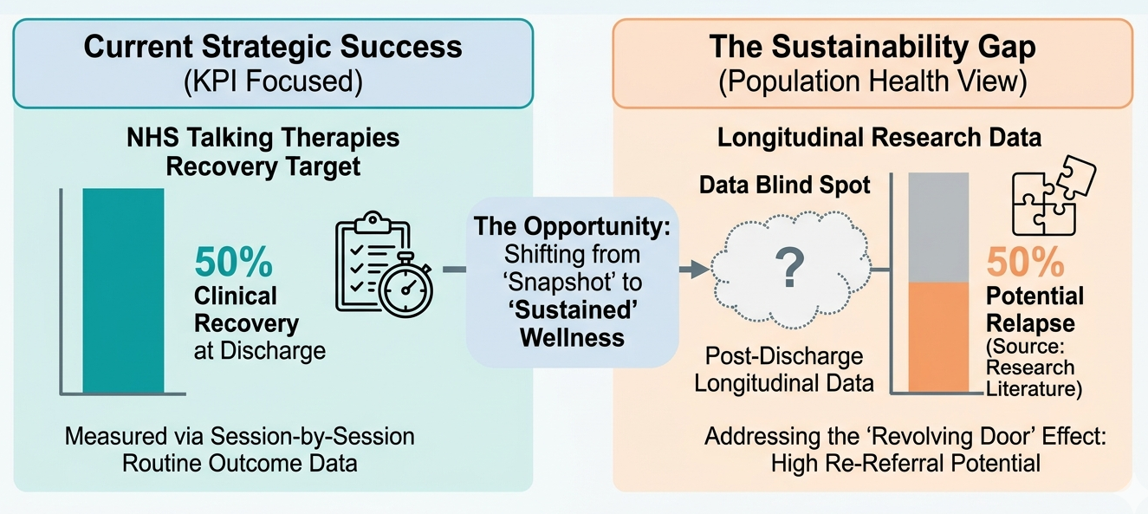
Beyond Discharge: The Sustainability Challenge
Notes:
The Data Paradox: While NHS Talking Therapies provides world-leading session-by-session data during treatment, we face a "data blind spot" post-discharge. Long-term follow-up is not currently a national mandate.
The Relapse Risk: International research and NHS-specific studies suggest that >50% of patients may experience relapse within one year, with the highest risk period occurring in the first six months post-treatment. This is a known challenge in psychological therapies globally that we now have the opportunity to lead on solving locally.
Okay, the gap is there—what are we doing about it? → Leading to introduce the project team
Question for forum at some point? How can we move from measuring recovery during treatment to ensuring 'Wellness at Month 12'?"

Slide 110
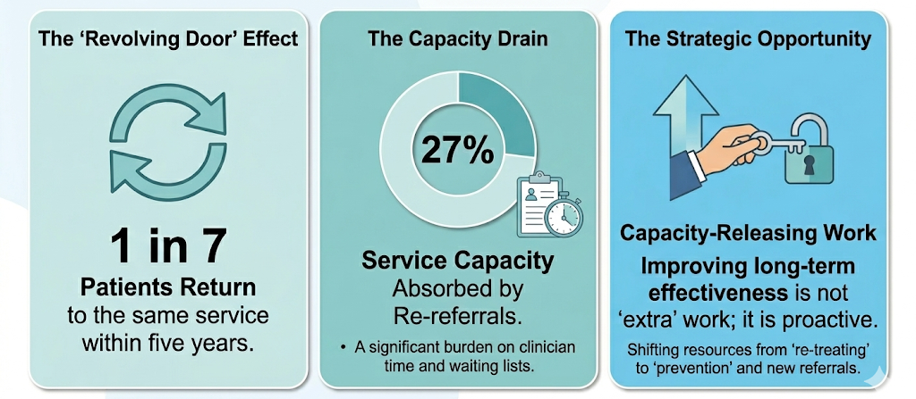
The Cost of the Sustainability Gap
Notes:
We cannot treat our way out of this problem with a 27% revolving door. Every appointment we give to a returning patient is one less appointment for someone on the primary waiting list. By investing in long-term stability, we are quite literally 'buying back' over a quarter of our clinic time
Caviar: This will be an understamation of re-referrals as this relates to one service specifically, check wording!!!

Slide 111


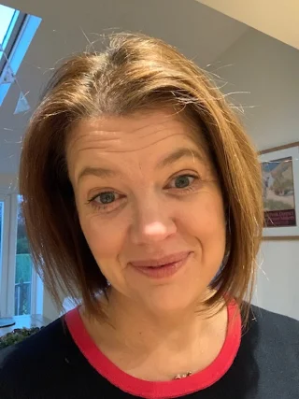
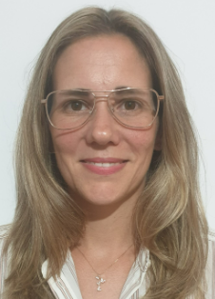
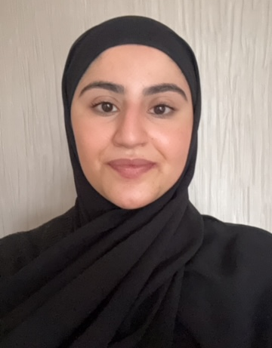



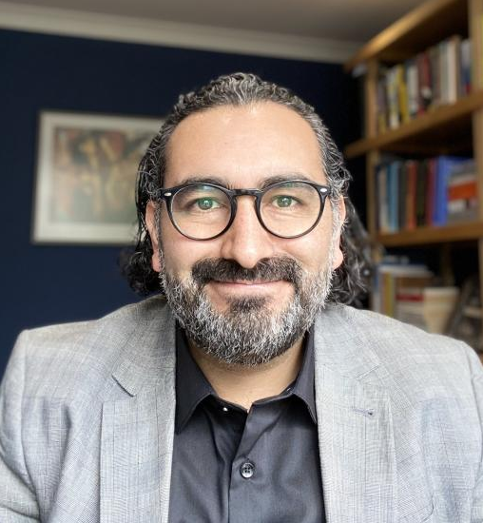

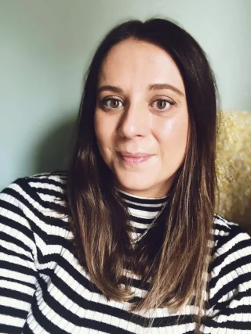



The Team
We are a multidisciplinary partnership dedicated to bridging the sustainability gap in psychological therapies.
Professor Dean McMillan
Collaborator
Dr Cintia Faija
Lead Investigator
Professor Penny Bee
Co-Lead Investigator
Saher Nawaz
Research Assistant
Professor Jaime Delgadillo
Collaborator
Professor Karina Lovell
Co-applicant
Dr Amy Blakemore
Collaborator
Peter Bampton
PPI Co-applicant
Notes:
We are the people behind bringing some light and understanding on this area. We are a group of clinical, academic, and service users working together, with the support of four NHS Trusts.

Slide 112

Project Foundation
The CO-IMPROVE research project was funded by the National Institute for Health Research (NIHR), Research for Patient Benefit (Ref: NIHR 204037). NIHR Mental Health Theme call.
Sponsor: The University Of Manchester
Host Trust: Greater Manchester Mental Health (GMMH)
Lead CRN: Greater Manchester
Project Length: 24 Months
Start Date: 01/12/2022
End Date: 31/12/2024
Total cost: £188,315.24
Research Aim: To enhance the long-term durability of clinical recovery following low-intensity interventions, simultaneously improving patient outcomes and service efficiency.
PPIE: A co-applicant and a lived experience group were involved in defining the research aim to ensure it reflects what matters most to patients' post-discharge.
Notes:
The aim is dual-purpose: we want patients to stay well, and we want the service to run more efficiently by reducing that 27% re-referral rate.
By focusing on the 'long-term benefits,' we are moving toward the NHS Long Term Plan's goal of proactive, rather than reactive, care
The CO-IMPROVE project if funded by the NIHR as part of the Research for Patient Benefit Mental Health Call. The Sponsor of the project is the University of Manchester and the NHS Host Tryst is Greater Manchester Mental Health.

Slide 113
Research Methodology Overview
Phase 1: Discovery | Phase 2: Co-Design | Phase 3: Translation
System Mapping & Analysis | Experience-Based Co-Design | Implementation Strategy
Scoping Review & 48 interviews (patients, staff and national leads) CFIR Data Analysis: Examining the Outer Setting, Inner Setting, and Provider characteristics | Four Multiple-Stakeholders Workshops (2 with patients & 2 with staff and leads) Mapping Agreement & Disagreement on relapse prevention priorities. | Shared Decision-Making workshop (patients, staff and national leads). Resource Mapping and Gap Analysis: Currently active, supported by Univ of Liverpool Participatory Research funding.
Outcome: Identification of systemic barriers and facilitators to sustainability. | Outcome: Evidence-informed priorities for sustained recovery. | Outcome: A valid Blueprint for tailored or bespoke NHS-TT and feasibility testing (further funding needed)
PPIE Embedded Throughout: Co-designing participant facing materials, interviewing schedule and piloting, regular group advisory meetings, and refining findings
Notes:
Phase 1: a scoping review to identify guided-self help intervention following guided self-help amd Interviews with patients (N=23), professionals national leads (n=25) to develop an in-depth understanding of the barriers/facilitators that contribute to support wellbeing and reduce relapse following low-intensity treatment on current practices routinely use to maintain recovery over time and identified opportunities to improve long-term treatment effectiveness in NHS Talking Therapies services. Method: Qualitative Interviews and data analysed via the lenses of Consolidated Framework for Implementation Research to guide the development and evaluation of complex interventions, allowing us deeper understanding of current practices including Intervention characteristics, outer setting, (3) inner setting, (4) characteristics of individual providers and process awareness for identification of opportunities for future implementation of changes.
Phase 2: Stakeholder Engagement via a Consensus‐Building Process. Four Co-development workshops with multiple stakeholders to share findings from phase 1 and identify the priorities and core elements to maintain treatment gains and prevent relapse following low-intensity treatment for anxiety and depression in IAPT/Talking Therapy services. A multiphase participatory design to synthesise evidence on relapse prevention and collaboratively develop evidence‐informed strategies for sustained mental health following low‐intensity treatment.
Phase 3: Shared decision making - A Workshop with multiple stakeholders to review how core recommendations AND PRIORITIES IDENTIFIED could be best translated into potential resources/materials and for whom and how to embed and assist uptake and facilitation as part of a next grant to test their feasibility and acceptability
PPIE: Involvement in development of research materials (e.g., advert), reviewing interview proposed questions and piloting interview. The group met throughout the project life. A sustained patient and public involvement (PPI) group reviewed and refined findings, co‐designing content for phase 3
Phase 1: We used the CFIR framework because we know that clinical effectiveness isn't just about the therapy—it’s about the environment. By looking through these different lenses, we identified that the 'inner setting' of the service often dictates whether a patient stays well long-term.
Phase 2: We used Experience-Based Co-Design to find where there was agreement, but also where there was disagreement. This tension is where the most honest insights live, ensuring our strategy works for the clinician as much as the patient. We truly listened to the nuances of where stakeholders might have different priorities.Disagreement provides insight: operational barriers (e.g., "Clinicians and patients want more sessions, and to do more follow-up, but Leads worry about capacity.
The "Why" of CFIR: "We didn't just ask 'what' works; we used the CFIR framework to understand the 'where' and the 'how.' This allowed us to look at the service culture (Inner Setting) and national drivers (Outer Setting) to see why recovery sometimes fails to stick.“"The CFIR analysis ensured we didn't just listen to stories; we categorized them into actionable domains like 'Service Culture' and 'National Policy’.”
The "Why" of EBCD & Disagreement: "In Phase 2, we moved into Experience-Based Co-Design. It was vital that we didn't just seek a 'polite consensus.' By identifying where stakeholders disagreed, we uncovered the real-world tensions—like the gap between clinical desire for follow-up and the operational reality of waiting lists.“We used Experience-Based Co-Design to capture the full spectrum of the service. We didn't just look for what everyone liked; we looked at where the staff and patients disagreed. This allowed us to build a Phase 3 strategy that is actually feasible in a high-pressure clinical environment.“
The "Why" of Phase 3: "Phase 3 was about translation. We took those tensions and turned them into practical tools that can be embedded into the pathway, ensuring this research leads to actual service improvement."
As the initial project progressed, we identified a critical need to bridge the gap between our 'Core Priorities' and 'Practical Delivery.' Because of the strength of our co-production work, we successfully secured additional funding via University of Liverpool Participatory Research. This is currently allowing us to map existing tools and, where necessary, develop bespoke resources that are fit-for-purpose for our staff and patients."
As you'll see on the next slide, this robust methodology led to three peer-reviewed publications, confirming that our 'real-world' approach meets high academic standards.
PPIE: Peter to speak about the PPI:
PPI members reviewed research documents, ensuring they were accessible and reflective of patient’s experiences.
For example, they revised interview schedules to simplify language and participated in pilot
Held interviews to refine research questions, enhancing researchers’ interviewing skills and ensure they approached questions sensitively.
Phase 1 Findings Review:
The PPI group reviewed and endorsed Phase 1 findings, sharing valuable resources (e.g., Therapy Blueprint, Psychology Tools) relevant to relapse prevention. Discussions focused on the findings’ implications for developing a transdiagnostic toolkit.
Preparation for Phase 2 Materials:
PPI members provided input on using platforms like FigJam and Mentimeter for online exercises (voting and ranking). Their insights influenced the adoption of these platforms, ensuring accessibility and anonymity for participants.
Phase 2 Co-Production Workshops:
PPI members collaborated with researchers to present study findings clearly and accessibly during coproduction workshops.
Follow-up meetings with a smaller co-design group refined the toolkit development process.
Dissemination of Materials:
PPI members reviewed and improved dissemination materials, such as a newsletter article published in the British Psychological Society, a lay summary, and a poster presentation.
Feedback led to less technical language and more effective design (e.g., one-page summaries, larger text).
A social media post, developed by a PPI member, included their personal experience, and emphasized the importance of PPI-led research involvement.
Additionally, three members participated in a co-design group to develop the Phase 3 findings presentation.

Slide 114
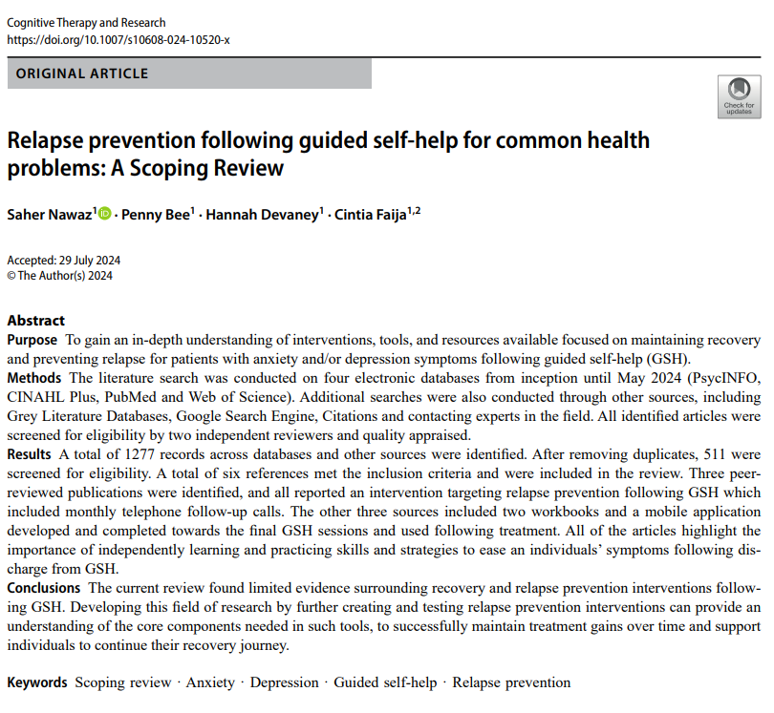
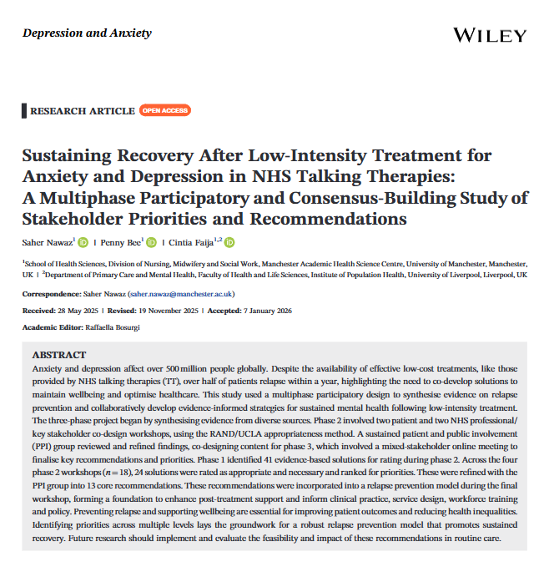
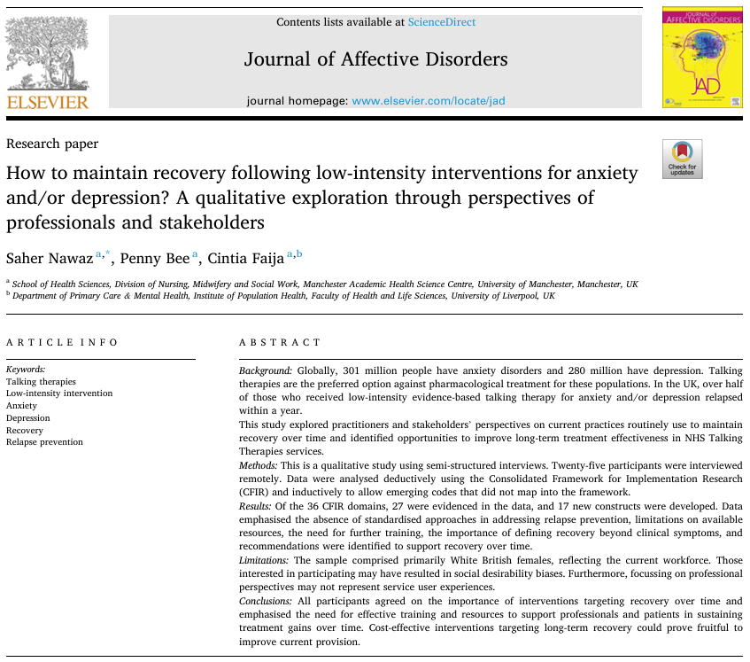
Co-IMPROVE Publications – All Open Access
Phase 1: Qualitative Study with professionals
Phase 1: Scoping Review
Phase 2 & 3:
Co-development workshops
Notes:
Our empirical work has been peer-reviewed and published in the Journal of Affective disorders and Depression and Anxiety ensuring the insights we are sharing today are academically rigorous.
The robustness of this three-phase approach is evidenced by our three peer-reviewed publications, validating our findings at every stage of the journey."

Slide 115
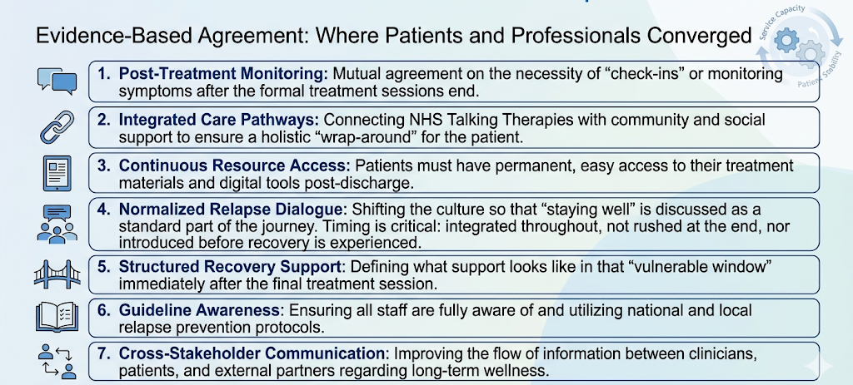
Phase 2: Evidence-based Agreement
The 7 Areas of shared priorities by Patients and Professionals
PPIE: This shared agenda was co-validated by our PPIE partners, confirming that these seven areas represent a unified vision for 'what good looks like' after discharge
Notes:
The fact that both groups agreed on 7 key areas gives us a 'Quick Win' roadmap. We know exactly what to prioritize first: materials and awareness."

Slide 116
Phase 2: The Perspective Gap – Divergent Needs:
Understanding Unique Stakeholder Priorities
PATIENT-ONLY PRIORITIES | PROFESSIONAL-ONLY PRIORITIES
Relational Safety Nets: Focused on long-term monitoring and support | Clinical Competence: Focused on CPD, University curricula, and supervision.
Dedicated Roles: Creation of a long-term recovery support role within the service. | Systemic Advocacy: Inclusion of patient representatives within service leadership.
Boundary Crossing: Facilitating direct contact with external support services. | Network Engagement: Encouraging involvement of friends/family to sustain gains.
Transparent Re-entry: Clarity on how to regain service access if symptoms return. | Reinforcement: Provision of 'booster sessions' specifically for recovered patients.
PPIE were integral to analysing this divergence, ensuring these priority gaps are understood through the lens of lived experience.
Notes:
This slide explains the ‘Sustainability Gap' we discussed earlier. If our staff are focused on training but our patients are crying out for a safety net, the service doesn't feel 'complete' to the user."
Key message: Finding: Patients seek continuity of connection in care, while professionals seek enhanced training and structure.
PPI for Peter to comment - This slide represents the core 'human tension' of the project. Patients want immediate security; staff want long-term skill development. We didn't just interpret these results from an academic silo. Our PPIE advisors—individuals with lived experience of the TTad pathway—were embedded on those discussions. They helped us make sense of this gap, grounding the analysis and ensuring we aren't suggesting solutions that patients don't actually want

Slide 117
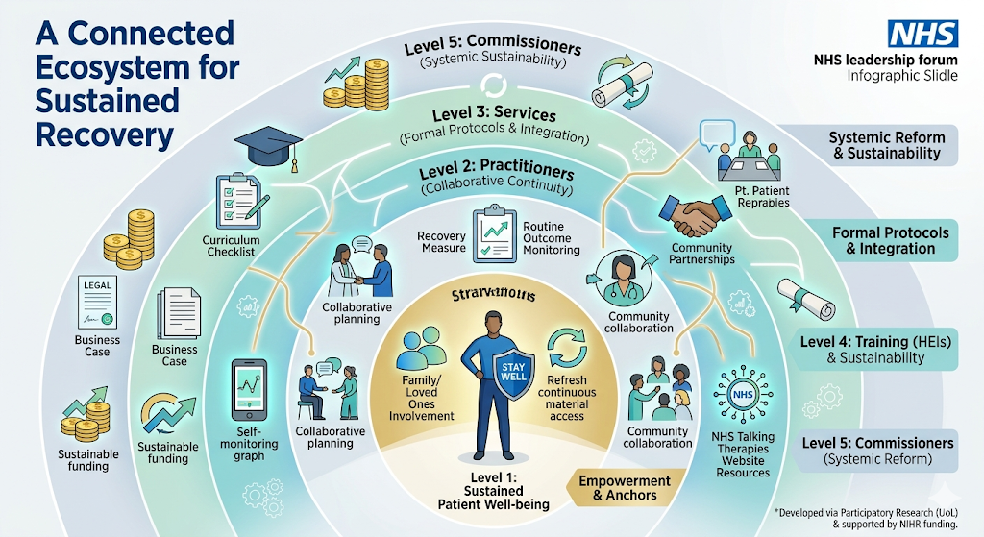
Phase 3: A Multi-Level Implementation Framework
CO-
IMPROVE
Notes:
This is about Interconnectedness:
The Whole System: "This ecosystem diagram represents our core finding: preventing relapse isn't a single person's job. It is a shared responsibility across five crucial levels. If any one of these circles is broken, the entire system leaks, and we see that 27% capacity drain."
The Clinical-Social Bridge: "Notice how 'Practitioners' are connected to 'Patients' and 'Services.' Our model moves beyond clinical therapy. We are arguing that clinicians must actively bridge patients to local community and social support networks. If we don't fix the social triggers, the clinical gains are lost."
The argument: "Finally, look at that outer ring. Policy and funding must provide the 'air' that allows the entire ecosystem to work. We are building the business case that a sustainable funding model for recovery is cheaper and more effective than a revolving door of crisis and re-referral."
Turning Weakness into Strength
The "So What?": "I want to be realistic with this forum. We know that identifying what needs to change is only half the battle. The biggest risk in any NHS research is the 'Implementation Gap'—where good ideas go to die in a PDF report."
The Proactive Stance: "As you can see from our mitigations, we aren't waiting for others to solve these problems. Our current University of Liverpool work and our NIHR bid are direct responses to these limitations. We are moving from 'Knowing' to 'Doing'."
The Capacity Argument: "When we talk about 'Workforce Capacity,' we aren't asking for more hours in the day. We are arguing that a small investment in these 7 consensus areas now will pay dividends by reducing that 27% re-referral rate that currently clogs the system.

Slide 118
Limitations and Mitigations: Real-World research
Regional Specificity
Mapping services to ensure we capture national relevance
Self-Selection Bias
Ensuring a broad range of voices
Implementation Gap
Turning recommendations into tools
Service Constrains
Focus on efficiency prioritising low-cost & high-impact tweaks

Slide 119
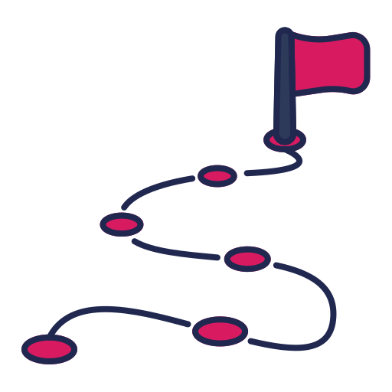
Next Steps
1. Active Translation | UoL Participatory Research: Conducting the resources audit and tailoring resources where needed with our partners.
2. Scaling & Piloting | NIHR RfPB Grant: Refining and piloting core recommendations resources. PPIE, Senior PWPs, and PPN NW as co-applicants.
3. Strategic Partnership | Service Collaboration: Invitation for NHS TTad services to join our research ambitions to guide local implementation and sustainability.
Co-production: Involving patients and providers as co-applicants ensures that the solutions we build are ones that they will use and sustain

Slide 120

Thanks for your attention.
Any Questions?

Slide 121
CO-IMPROVE
Contact details:
Cintia.faija@liverpool.ac.uk pbampton@me.com

Slide 122
Reference List
Ali S., Rhodes L., and Moreea O., et al. (2017). How Durable is the Effect of Low Intensity CBT for Depression and Anxiety? Remission and Relapse in a Longitudinal Cohort Study. Behaviour Research and Therapy, 94, 1–8.
Breedvelt, J.J.F., Karyotaki, E., Warren, F.C. et al. (2024). An individual participant data meta-analysis of psychological interventions for preventing depression relapse. Nat. Mental Health, 2, 154–163.
Buckman JEJ, Saunders R, Fearon P, Leibowitz J, Pilling S. (2019). Attentional Control as a Predictor of Response to Psychological Treatment for Depression and Relapse up to 1 year After Treatment: A Pilot Cohort Study. Behavioural and Cognitive Psychotherapy, 47(3),318-331.
Clark D. M., Layard R., Smithies R., Richards D. A., Suckling R., and Wright B. (2009). Improving Access to Psychological Therapy: Initial Evaluation of Two UK Demonstration Sites, Behaviour Research and Therapy, 47(11), 910–920.
Delgadillo J., Rhodes L., and Moreea O., et al. (2018). Relapse and Recurrence of Common Mental Health Problems After Low Intensity Cognitive Behavioural Therapy: The WYLOW Longitudinal Cohort Study. Psychotherapy and Psychosomatics, 87(2), 116–117.
Lorimer, B., Delgadillo, J., Kellett, S., & Brown, G. (2020). Exploring relapse through a network analysis of residual depression and anxiety symptoms after cognitive behavioural therapy: A proof-of-concept study. Psychotherapy Research, 30(5), 650–661.
Lorimer B, Delgadillo J, Kellett S, Lawrence J. (2021). Dynamic prediction and identification of cases at risk of relapse following completion of low-intensity cognitive behavioural therapy. Psychother Res, 31(1),19-32.
Lorimer B., Kellett S., Giesemann J., Lutz W., and Delgadillo J. (2024). An Investigation of Treatment Return After Psychological Therapy for Depression and Anxiety, Behavioural and Cognitive Psychotherapy, 52(2), 149–162.
Lucock, M., Bartys, S., Cupac, J., Delgadillo, J., Denton, C., Gaines, S., McMillan, D., Prestwich, A., & Stebbings, R. (2018). Using implementation intentions to prevent relapse after psychological treatment for depression–the SMArT intervention. Behavioural and Cognitive Psychotherapy, 46(5), 626–632.
Lucock, M., Borthwick, R., Cupac, J., Elliott, R., Howell, R., Kendal, S., Khan, W., Sandford, D., & Tolley, B. (2021). Using implementation intentions to prevent relapse after remission from psychological treatment for depression: The SMArT intervention. Psychotherapy Research, 32(4), 428–439.
Roscoe J. (2019). Has IAPT Become a Bit like Frankenstein’s Monster? CBT Today, 47(1),16–17. https://insight.cumbria.ac.uk/id/eprint/6535/
Nawaz S., Bee P., Devaney H., and Faija C. (2024). Relapse Prevention Following Guided Self-Help for Common Health Problems: A Scoping Review. Cognitive Therapy and Research, 49(1), 1–17.
Nawaz S., Bee P., and Faija C. (2025). How to Maintain Recovery Following Low-Intensity Interventions for Anxiety and/or Depression? A Qualitative Exploration Through Perspectives of Professionals and Stakeholders. Journal of Affective Disorders, 372, 582–597.
Nawaz, S., Bee, P., Faija, C. (2026). Sustaining Recovery After Low-Intensity Treatment for Anxiety and Depression in NHS Talking Therapies: A Multiphase Participatory and Consensus-Building Study of Stakeholder Priorities and Recommendations. Depression and Anxiety. 9916526
NICE. (2011). Common Mental Health Problems: Identification and Pathways to Care, National Institute for Health and Care Excellence.
NHS. (2024). NHS Talking Therapies, for Anxiety and Depression, Annual Reports, 2022–23, UK Government.
NHS. The National Collaborating Centre for Mental Health, NHS Talking Therapies for Anxiety and Depression Manual.
WHO. (2023). Depressive Disorder (Depression) https://www.who.int/news-room/fact-sheets/detail/depression
Wojnarowski, C., Firth, N., Finegan, M., & Delgadillo, J. (2019). Predictors of depression relapse and recurrence after Cognitive Behavioural Therapy: A systematic review and meta-analysis. Behavioural and Cognitive Psychotherapy, 1–16.

Slide 123
Closing Remarks
Reminder - Survey to be sent round, please complete to influence future Forums
Thank you ☺

