Slide 1
Psychological Professions Week 2026
Communication Pack
9 – 13 November 2026

Slide 2
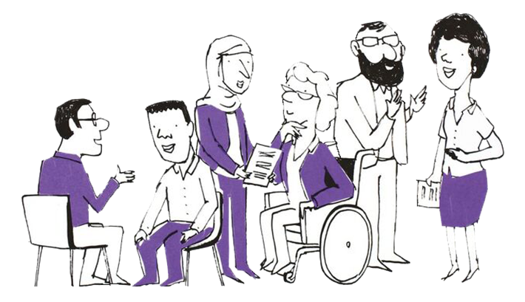
What are the Psychological Professions?
In England, the psychological professions are a group of professionals whose work is informed by psychology and psychological therapies. They work with people to alleviate psychological and emotional distress, to improve mental and physical health management and empower individuals and communities to improve their health and wellbeing.
The psychological professions include psychologists, psychological therapists and psychological practitioners. Read more about the range of occupations on the
Health Careers website and the PPN Careers Map.
Our Vision
To transform lives and communities by embedding and developing
psychological knowledge and practice across the whole of health and care.

Slide 3
Background
There are 34,000 whole-time equivalent (WTE) psychological professionals — including psychologists, psychological therapists, and psychological practitioners — working within NHS-commissioned healthcare in England. The size of this workforce has more than doubled since 2016. Psychological professions now contribute increasingly across mental health and additional care pathways, encompassing acute healthcare, rehabilitation, and primary care.
The NHS 10-year health plan outlines a strategic transformation of healthcare over the next decade, focusing on three shifts: hospital to community, analogue to digital, and sickness to prevention. Psychological professionals are essential to the successful delivery of this plan, applying their expertise to ensure that all health and care services are psychologically informed. They lead significant pathways of care to deliver on policy objectives including NHS Talking Therapies and Mental Health Support Teams in schools and will be instrumental in achieving the three shifts in the 10 Year Health Plan.
To facilitate these aims, NHS England has established the Psychological Professions Networks (PPNs) both nationally and across the seven regions in England. These networks provide a unified voice for psychological professionals in workforce planning and development and promote excellence in practice. The PPNs currently have over 19,000 members.
Since 2020, during the second week of November, the PPNs have coordinated events dedicated to highlighting and celebrating the achievements and impact of the psychological professions as part of Psychological Professions Week.

Slide 4
Psychological Professions Week 2026 - Objectives
Showcase the contribution of the psychological professions to delivering the NHS three shifts and improving outcomes for people and communities.
Raise awareness of the 21 psychological professional roles, their career pathways, and workforce growth ambitions.
Engage and inspire a diverse audience through regional and local Psychological Professions Week events.
Encourage organisations and individuals to celebrate, promote and engage with the psychological professions and the Psychological Professions Networks (PPNs).

Slide 5
Psychological Professions Week 2026
- PPN Regional Events
PPN regional events are aimed at PPN members, prospective members, the public and wider stakeholders so they can come together to celebrate the psychological professions. The sessions will be an opportunity to learn, engage, influence and drive strategic ambitions to develop the professional group for the benefit of patients and the public.
Throughout the week, PPN regionally-led virtual and in-person events will be held.
Find out more and register for sessions: PPWeek26 Programme
For more information visit: www.ppn.nhs.uk

Slide 6
Psychological Professions Week 2026
Join in and be part of the movement for a more psychological NHS
This year, we are again asking organisations, services, teams and individuals to develop and deliver local events and communications to celebrate the great work the psychological professions do in the NHS.
Please consider the following guidance for events and communications:
Align events and communications to the Vision for the Psychological Professions and the NHS 10 year health plan three shifts: sickness to prevention, hospital to community and analogue to digital.
Support the building of bridges between practitioners, policy, and the public
Recognise and support the unique and valuable contribution of all 21 psychological professions
Involve people with lived experience in the design and delivery of events, alongside psychological professionals (and for regional and national events, NHS England colleagues)
Demonstrate the impact the psychological professions have on delivering high quality healthcare for patients, carers, and families
Promote the delivery of national policy and local innovation in ways that are in synergy
Encourage people to join the PPN to be part of the movement for a more psychological NHS.

Slide 7

Psychological Professions Vision for England

Slide 8
How to be part of PPWeek26
We need your help to encourage colleagues, organisations and partners to mark Psychological Professions Week 2026.
You can help to do this by:
Adding the PPWeek26 email signature image to your emails during September to November
Using the PPWeek26 Teams backgrounds during October and November
Encourage people to join the PPN to be part of the movement for a more psychological NHS
Developing creative and authentic local content to promote Psychological Professions Week across your platforms
This can include profiling and telling the stories of psychological professionals, service users who have benefited from their services, sharing job and career opportunities that are available, creating blogs, posting on social media, developing local news stories, running virtual or face to face events.

Slide 9
How to be part of PPWeek26
You can help us do this by:
Sharing, via your channels, networks and social media, the details of Psychological Professions Week 2026, national webinar, regional events, local events, PPN website, key messages, communication assets and membership links.
Don’t forget to share your activity with us. You can also tag relevant regional PPN accounts on various social media platforms:
Psychological Professions Network North West | LinkedIn
Psychological Professions Network Midlands | LinkedIn
Psychological Professions Network South West| LinkedIn
Psychological Professions Network London | LinkedIn
Psychological Professions Network East of England | LinkedIn
Psychological Professions Network North East and Yorkshire | LinkedIn
Please use the hashtag #PPWeek26 or #PsychologicalProfessionsWeek2026 in all posts.

Slide 10
Key dates
1 September 2026: Psychological Professions Week 2026 Communications Commence
28 September 2026: Registrations open for PPN Regional Events (PPWeek26 Programme) (please check individual event information)
2 November 2026: 'One week to go' communications
9 – 13 November 2026: Psychological Professions Week 2026!

Slide 11
Audience
Everyone is welcome to mark Psychological Professions Week 2026 across England and join the national webinar and PPN regional events!
Our audiences include:
Psychological professionals – qualified, training and aspiring
Experts by Experience and people with lived experience
Policymakers
Education, workforce and career leads and teams
NHS commissioned service providers
Members of the public interested in the psychological professions and NHS services.

Slide 12
Key messages
Psychological Professions Week 2026 is taking place 9-13 November 2026.
The week is led by the Psychological Professions Network and aims to celebrate the impact and highlight the potential of the psychological professions.
Join us in celebrating Psychological Professions Week 2026!
Add the Psychological Professions Week logo to your email signature and use the Teams backgrounds.
Encourage your organisations, services, team, and colleagues to develop and deliver local events and communications to celebrate the great work the psychological professions do in the NHS.
Register and attend one or more of the PPN regional sessions, and the national webinar.
View the PPN regional events programme and how to register at PPWeek26 Programme.
All PPN events are free for members!
It is FREE to become a member of Psychological Professions Network, visit www.ppn.nhs.uk. Join the PPN to be part of the movement for a more psychological NHS.

Slide 13
Assets
Using the link to the PPN website, you’ll find one central hub for all the Psychological Professions Week 2026 assets:
GIF
Logo
Email signatures
Background Images
Communication Pack

Slide 14
Further information
For further information or queries, please contact your regional PPN.
PPN - East of England
PPN - London
PPN - Midlands
PPN - North East and Yorkshire
PPN - North West
PPN - South East
PPN - South West
If you require information about Psychological Professions Week 2026 or this communications pack, please contact your regional PPN.

