Slide 1

Who’s missing from the couch? Rethinking diversity in psychological professions
Priyanka Ayodele, EDI Lead
Improving Lives

Slide 2

Introduction
Priyanka Ayodele – EDI Lead –at PTTC Priyanka.Ayodele@gmmh.nhs.uk
Work with Low intensity doing work around recruitment, teaching content and EDI advice and guidance

Slide 3

What We Did
Reviewed UK and global literature on workforce diversity
Focused on psychological professions
Looked at impact on service user outcomes

Slide 4

What We Found
Diversity improves service outcomes (trust, engagement, communication)
UK: Ethnic minorities underrepresented, especially in leadership
Systemic barriers: bias, weak recruitment inconsistent training
Global success: US, Canada and Australia use targeted strategies

Slide 5

Why It Matters To Us
Local services reflect the national picture
Lack of diversity = disconnect with service users
We need inclusive recruitment, better training and clear targets
Time to move on from performative to meaningful action
Notes:
Add a slide – with the screenshot of the lit saying it will be sent out and circulated for everyone to access and an introduction slide

Slide 6
Ethical, Business and Policy Perspectives
Ethical – fairness and equal opportunity – it helps address structural inequalities and creates better representation across all levels
Business – diverse teams lead to better decision-making, higher retention, and improved satisfaction (Monks and Clennell, 2025)
A workforce that reflects our local communities builds trust and improves patient outcomes
Policy – NHS EDI Improvement Plan- shows system-wide commitment to inclusivity
NHS Long-Term Plan – supports fair and transparent recruitment
Workforce Race Equality Standard (WRES) – Holds organisations accountable to diversity goals

Slide 7
Widening Access to Trainee EMHP roles
Caroline Browne, EMHP Programme Lead, PTTC
08/07/25
Improving Lives

Slide 8
Aims
Summary of widening access initiatives within Trainee EMHP recruitment
Wave 11 & 13 - longlisting & group interviews
Reflections & feedback from services
Data
Notes:
Ethical Perspective – It creates fairness and equal opportunities - fundamental values. It addresses systemic barriers ensuring representation at all levels​
The NHS EDI Improvement Plan – System-wide commitment to inclusivity ​
NHS Long Term Workforce Plan – Ensures recruitment processes are fair and transparent ​
Workforce Race Equality Standard (WRES) - Holds NHS organisations accountable for their diversity goals

Slide 9
Background
Lack of diversity within past trainee cohorts, particularly in relation to ethnicity & gender
Regional variance
Identify and remove barriers in recruitment
Ensure that our EMHP workforce includes staff with a diverse range of protected characteristics in the workforce and ensure that CYP have a say in selection

Slide 10
Trainee EMHP Data - Ethnicity

Slide 11
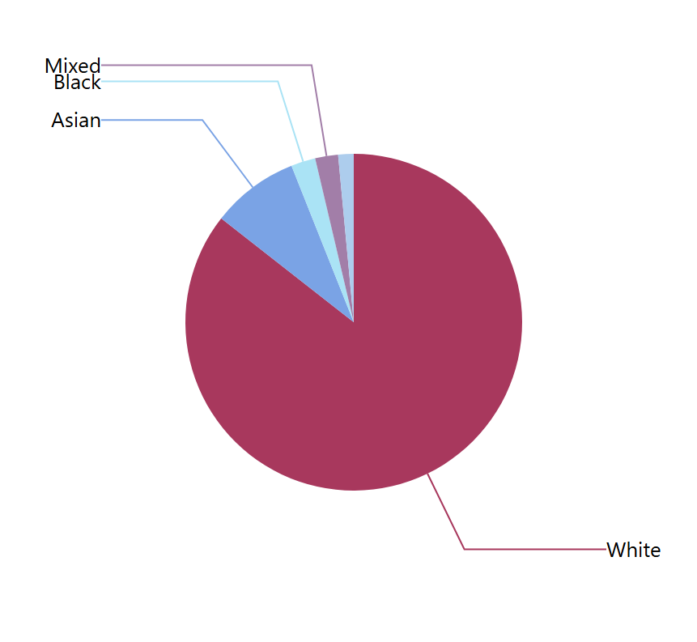
Population by race in North-West England, 2021 census
White - 85.6%
Asian - 8.4%
Black - 2.3%
Mixed - 2.2%
Other - 1.5%

Slide 12
Wave 11 Widening Access Initiatives
Conversations at EMHP board meetings
Engaging services through individual meetings
Creation of recruitment checklist
Revisiting JD’s & PS’s
Ensuring that applicants without an undergraduate degree were not being ruled out
Assisting with shortlisting/longlisting
Advertising in new places (HCA FB page, BAATN)
Encouraging CYP participation
Introducing new recruitment methods (longlisting & group interviews)

Slide 13
 | Yes/No | Comments
Job advert
States that the post is open to both graduates and non-graduates
Actively encourages applicants with a diverse range of protected characteristics/ applicants from under-represented groups and communities
Salary is stated
Advert is posted on multiple websites including local/national BAME groups/ communities e.g. www.baatn.org.uk |  | *please list where advertised
Advert is left open for at least 2 weeks
A webinar/ Q&A session is offered pre-interview to increase applicants’ understanding of the role
Person Specification
Focuses is predominantly on skills, competencies & values rather than on academic qualifications
An undergraduate degree or higher-level qualification is not specified as an essential/ desirable criteria (can say instead that ability to study at postgraduate level is required)
Shortlisting/ Longlisting
Efforts are made to longlist in order to widen access (e.g. a 2 stage interview process whereby larger numbers of candidates are assessed at group interviews prior to individual interviews)
Clear scoring criteria are used for shortlisting/longlisting
Shortlisting/longlisting criteria focuses more on vocational experience, skills and competencies than on academic qualifications
Candidates without a degree are not ruled out on this basis alone
Interview
Invitation encourages interviewees to make contact to discuss any additional needs/ reasonable adjustments required
Ensure interviews do not fall on key religious holidays
Diversity of panel members is considered & encouraged
Interviews are conducted face to face (unless a remote interview is required to facilitate additional needs)
Service users (e.g. CYP panels/ representatives) are included in a meaningful way
Clear scoring criteria are used for selection
Questions based on values and strengths are included
A question relating to diversity/ positive action is included
A question relating to participation is included

Slide 14
Longlisting
A Long-List is an initial list of candidates who meet the basic requirements for a job role. This list is often created after the first round of screenings of applications and serves as the starting point for further evaluations and interviews.
The aim of a longlist is to have the largest possible sample of candidates based on the essential requirements. If the manager or recruiter starts to interpret candidates’ applications during the long-listing process, potentially suitable candidates may be rejected.
Widens the pool of applicants who make it to the stage of being ‘seen’ by services.

Slide 15
Group Interviews
A type of interview that involves multiple candidates at the same time
Allows recruiters to assess the applicants' teamwork and interpersonal skills
Can help reduce bias because they often involve multiple interviewers
Variety of tasks & formats (sharing pen profiles, problem solving, puzzles, discussion topics, group presentations)
Scoring system

Slide 16
Wave 11 Interviews
2 of our 8 service partners agreed to longlisting and group interviews
6 of our 8 service partners included CYP panels/participation

Slide 17
Applicants seen (Wave 11)
 | Total Applications | Number longlisted | Number attending group interviews | Number attending individual interviews | Number appointed
Alderhey (Sefton) | 104 | 67 | 48 | 14 | 6
Merseycare |  |  |  |  | 5

Slide 18
Service feedback - what went especially well?
“The longlisting and group session and role play. Also made us think about great applicants with potential and developing an assistant EMHP role”
“The group interview sessions were well received, this allowed us to see how candidates interacted with peers, their ability to work as part of a team, an opportunity to showcase their individuality and personality using the 1-page profile”
“Diverse nature of experience of the applicants and their cultural diversity”
“Using a patient by experience went really well. It is something that I will continue to take forward”
“YP panel”

Slide 19
Service feedback - what would you like to do differently next time?
“Have a clearer scoring structure for group interviews”
“Extend the duration of the group interviews to allow candidates more time to feedback on 1 page profiles”
“Sending people home felt like the X Factor”

Slide 20
Reflections from Wave 11 (N=47)
Reaches so many applicants who may get overlooked
Significant increase in trainees from ethnic minorities in Wave 11 in comparison to the previous 2 cohorts
Number of male trainees in line with previous cohorts.
6 of the successful applicants did not have undergraduate degrees
Positive feedback from services about longlisting
Feedback from EMHP staff team really positive

Slide 21
Ethnicity

Slide 22
Gender
Notes:
3 males out of 47

Slide 23
Previous Level of Academic Qualification

Slide 24
Wave 13 Recruitment
Smaller cohort of mainly attrition places (approx 24)
3 services have already engaged in longlisting & group interviews
Notes:
MFT, Wirral, Barnado’s

Slide 25
Applicants seen (Wave 13)
 | Total Applications | Number longlisted | Number attending group interviews | Number attending individual interviews | Number appointed
MFT | 120 | 20 | 15 | 12 | 4
Barnado’s | 84 | 18 | 13 | 9 | 3
Wirral | 229 | 45 | 42 | 10 | 4

Slide 26
Next steps
Additional data collection – tracking protected characteristics at each stage of recruitment – are there significant changes?
Aim to get a full cohort of recruitment data from HR’s!
Share best practices across services to make sure there is wider implementation of successful strategies
Continue refining processes to make recruitment more equitable and effective

Slide 27
Thank you
&
Questions?

Slide 28
Increasing reach. Longlisting: A Case Study
Increasing reach.
Longlisting: A Case Study
Julia Dunn: Assistant Clinical Lead, Sefton CAMHS
Katie Jamieson: Senior Wellbeing Practitioner, Sefton CAMHS
Emma Gilbody: Mental Health Practitioner, Sefton CAMHS

Slide 29
How does longlisting widen access?
Increased Representation: A larger candidate pool increases the chances that those from underrepresented groups, including racial and ethnic minorities, with disabilities, and those from lower socioeconomic backgrounds, are included in the initial stages of selection
Longlisting allows for a more thorough review of each candidate's profile, potentially revealing hidden qualities and skills that might be overlooked in a shortlisting process
By promoting diversity in the applicant pool, longlisting can lead to more diverse and inclusive teams, promoting innovative, productive, and better equipped practitioners, to work with patient/service user diverse needs.
Improved Outcomes: For individuals from lower socioeconomic backgrounds, longlisting can provide opportunities for those who may not have had access to the same resources and networks as more privileged peers, helping to promote social equality and social mobility

Slide 30
Promoting Diversity and Inclusivity
Promotes a more inclusive workforce:
A more diverse trainee cohort leads to a more diverse and culturally competent mental health workforce: Better equipped to serve the needs of all communities
Shortlisting often relies on initial screening criteria that may inadvertently favor candidates from certain backgrounds, such as those with more conventional career by including more candidates, reduces the impact of these biases and allows for a wider range of experiences and qualifications recognised.
Widen the net: longlisting increases the likelihood of identifying individuals with unique skills and perspectives that might not be readily apparent in a smaller pool of candidates. This can lead to a more diverse and innovative workforce

Slide 31
Longlisting process
Longlisting candidate application forms
Collaborative longlisting
Organising the longlisting day
Our experience: Operational, CAMHS clinicians, Parent/carer and Young person’s experience
Collaborative learning and next steps

Slide 32
Parent/carer and Young person participation
We invited our parent participation representative and a young person accessing our service, to be part of the interview panel during the longlisting day.
They joined 2 CAMHS staff to observe the candidates deliver a 2-minute presentation on themselves, based on a 1-page profile they were asked to complete in advance.
They scored the presentations out of 10 and wrote down qualitative feedback. This was not shared with candidates but used to support decision making about which candidates would progress to the 1:1 interview stage

Slide 33
What went well:
Having a young person and parent representative on the panel brought their own lived experiences and unique perspectives into the recruitment process.
This was particularly helpful when assessing skills such as listening, empathy and teamwork. Young person’s experience of the candidates interpersonal and communication skills.
Candidates were also able to interact with the young person and parent directly, providing further opportunities to show interpersonal skills with people representative of the groups they would be working with if successful.

Slide 34
Challenges:
Scoring was inconsistent as there was no clear matrix specifically for the group activities.
Challenge making decisions in the group of clinician and parent/carer, young person at longlisting day.
“getting a feel” for a person was sometimes prioritised over scoring based on evidence of a clear set of skills and qualities. Some candidates scored well on some tasks but not others. In these cases, the views of the young person and parent representatives were used to make the final decision.

Slide 35
Next steps ….
Use a clearer and more objective scoring system to assess the presentations.
Ensure clarity around how final decisions are made when there is a difference of opinion.
Consider representation on the panel from a more diverse population.
A standardised scoring method could help to mitigate any unconscious bias.

Slide 36
Parent/Carer Feedback

Slide 37
Generic feedback
Good overall experience
Positive way of working collaboratively with other services
Enjoyable being included and part of the process
Good opportunity to witness people engaging in a different environment
Good opportunity to review how people interact with others
Specific activities feedback

Slide 38
Next steps…
Ensure representatives from all involved parties are present – CAMHS, HEI, Venus
Interview questions need to be updated regularly to ensure fairness for new candidates
Consider updating statements used for group task
Ensure that detailed information is shared with regards to the tasks and expectations of the day

Slide 39
CAMHS Feedback – Staff

Slide 40
Generic feedback
A great start to changing how we recruit CYWPs
Positive overall experience
Working with a smaller group of candidates was better
Good opportunity to view engagement with others
Good opportunity for people to share information about themselves (A4 profile)
Specific activities feedback

Slide 41
Next steps…
Consider smaller groups of candidates – allows for the day to be structured better and for a less pressured environment for candidates
Consider multi agency working – collaboration between HEI/Venus and CAMHS
Update interview questions and tasks to ensure they remain relevant and to allow for fairness for new applicants
Communicate clearly the requirements of the day, including the tasks, to applicants prior to attending
Consider how we give feedback to those who were not successful
Consider the process for applicants to make us aware of any additional requirements

Slide 42
CAMHS Feedback - current trainees

Slide 43
Generic feedback
Good to have involvement of YP and parent/carer
Approach of longlisting day widened access as it allowed for interpersonal skills to be portrayed that may have been missed on an application
Made to feel at ease by service representatives
Personal profile task was good to show personality of individual applicants
Interesting debate topics
Specific activities feedback

Slide 44
Next steps…
Consider small groups in attendance to reduce any sense of overwhelm
Consider location of event to ensure that there is space for everyone – particularly upon arrival
There was a range of diverse applicants in attendance at the longlisting day, however, this was not fully reflected at selection – how is this assessed for future cohorts?
How are older applicants supported to access programmes such as CYWP with regards to progression?
The application form asks about reasonable adjustments – can this be discussed again at the point of longlisting?

Slide 45
In Summary
All involved in the process shared positive feedback about their experience, and how the longlisting process can contribute to widening to psychological trainings to create a more representative & diverse workforce
Learning and next steps follow shared themes:
Investing more time to improve the organisation of the longlisting day
increasing the participation opportunities throughout the process
To promote a diverse interview panel
To widen evaluation methods and capture all candidates experiences.

Slide 46
References/further reading
Allan, S. M., & Travers-Hill, E. (2019). Service user interview panels for recruitment to UK child and adolescent mental health services: A questionnaire study exploring the experiences of young people, staff and candidates. Patient Experience Journal, 6(3), 50–54
https://indepth.nice.org.uk/our-5-year-workforce-equality-diversity-and-inclusion-roadmap/index
https://www.hee.nhs.uk/our-work/mental-health/children-young-peoples-mental-health-services

Slide 47
Widening Inclusion through Progression Roles in MFT MHST's
Vicki Dunham – Head of Early Intervention and Prevention, MFT
Addis Campbell – Assistant Educational Mental Health Practitioner, Salford MHST
July 2025

Slide 48
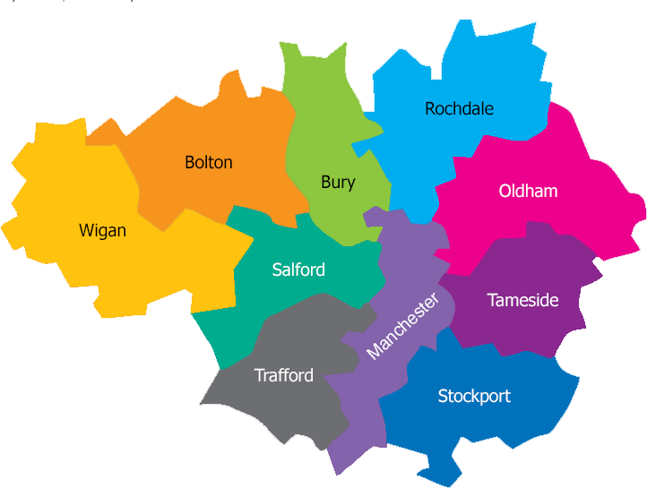
Who are we?
MFT MHST's are in North Manchester, South Manchester, Salford and Trafford
Ethnically and socio-economically diverse areas:
Manchester’s population is 57% White British, 21% Asian
Largest Jewish population outside of London in Salford
Trafford’s population is 77% White British and 12% Asian

Slide 49
Current Barriers in MHST Recruitment
MFT MHST teams are not currently representative of the local population (unlike MFT Thrive Hubs)
General demographics of MFT MHST's - white, female, aged 20-29
Commitment to address this by recruiting Trainee EMHP’s from diverse groups but some significant challenges
Trainee EMHP posts are in very high demand
Posts close early (average 5 days) with 100+ applications received
Stringent criteria for shortlisting can exclude local communities
Potential Solution to Increase diversity in MFT MHST workforce
Created B3 Assistant EMHP posts – 1 in each MHST
12-month Fixed Term Contract
Essential criteria has more focus on knowledge of local community (essential criteria) than qualifications (GCSE in Maths and English, grade 4 or above )
Progression route into Trainee EMHP posts

Slide 50
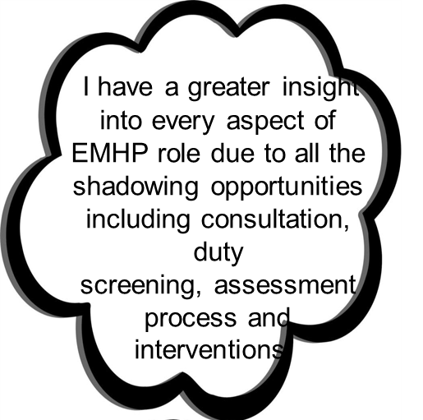


My Experience of being an Assistant EMHP
Gained valuable experience and training opportunities. E.g. I am part of the mini-ND team within my service. I am QB trained and have facilitated HAVEN sessions for neurodivergent YP
I have the flexibility to shadow professionals outside of my immediate team, for example, Core CAMHS practitioners, Clinical Nurse Specialist, and Clinical Psychologist. This experience has broadened my understanding of the wider network of mental health services and mental health needs.
I was successful in my recent interview and due to start as a Trainee EMHP next month

Slide 51

What I bring to the team
Lived experience (Intersectionality​)
Being a black woman from a Jamaican background and having major transitions of my own. Moving to England from the age of 8 and living the second part of my childhood in a different country. Struggling with my identity and code switching from an early age, I had a black mentor to help me. I bring that experience and knowledge.
Cultural Competency
Increased understanding of the importance of cultural competency/awareness and understanding of protected characteristics that makes an individual. I co-delivered cultural competency training with Core CAMHS, helping to break down unconscious bias and always promoting exploration and curiosity
Representation
It is often mistaken that marginalised communities are harder to reach, when it is services that are harder to access. It is vital we break down barriers to engagement through having more diverse teams that represent those communities.
Resources
I strive to ensure resources that I create for individual sessions with young people or service promotion is representative of marginalised communities. This is something I rarely witnessed growing up and in current times. I want young people and parents/families to feel well represented in what they look at and read.

Slide 52
What I bring to the team
Community awareness
I work closely with the CWYP in the team. We deliver workshops to organisations who cater for those from ethnic minority groups. We endeavour to communicate in accessible ways, - having more specific things that they experience within those background traditions/ culture.
Increased Engagement
Through interactions with young people from similar backgrounds, I have experienced first-hand their excitement to work with someone who looks like them. This helped greatly with engagement.
Visibility
I was a part of a CAMHS recruitment campaign. it was very powerful to represent those from marginalised communities that are otherwise not well represented in mental health services.

Slide 53

The impact for young people
Relating Through Shared Identity
During a drop-in at a high school, I met a mixed-race girl who struggled to engage. I gently asked if she was okay. She shared that she felt uncomfortable because her hairstyle had changed — she usually wore box braids but now had slicked-back hair and felt less confident.
I had just made a similar change myself, so I could relate. That small point of connection, which might seem minor to others, was deeply meaningful to her. You could visibly see her relax once she felt understood.
Being a Safe Person
I recently co-delivered an anxiety psychoeducation workshop for young people transitioning into high school. One young black girl's face lit up when she saw in the room. During the session, she bravely disclosed to the group that she was experiencing racism. That moment reminded me how powerful it is just be present – and how representation can open the door to speak about matters that are specific to us.
Cultural Conversations in Community Groups
Working with the CWYP in my team , I have found that young people from marginalised community really want to more specific conversation about their background, struggles and the difference to their peers. They can feel more seen, heard and safe when someone can reflect those aspects of their identity
Representation Matters
I've worked with many young people from ethnic minority backgrounds who have shown real excitement when I co-deliver sessions. I have had comments such as: You look like my mum, I really like your braids, oh, is that a Jamaican flag on your earrings?"
Young people also often share their ethnic background with me. I believe this shows how having a representative professional in the room improves that connection, interaction and engagement

Slide 54
Barriers and Solutions to employing a diverse workforce
Barriers | Solutions
Individuals from ethnic minority background often face rejection early in a recruitment process due to unconscious barriers of recruiters. Within my cultural background it is often suggested to have a western name improves the likelihood of been invited for interview. | I wasn’t initial aware that names/ethnicity are hidden when shortlisting. I think this needs to be highlighted to applicants as it could encourage people from ethnic minority backgrounds to apply if they are assured there is not that initial bias.
Lack of diversity and hierarchy position in interview panels. | In my interview for the Assistant EMHP role one of the panel members was an Asian Muslim woman, already working as an Assistant EMHP. This helped break the hierarchy and build inclusiveness. I felt safe, seen and heard during the interview. Develop less hierarchical and more diverse interview panels
Experience of working in non-diverse staff team and area. At the start, I was filled with anxiety as I didn’t know how I will fit in. There were moments where I felt I was code switching, but then I started to feel more and more comfortable as the team were extremely welcoming. I have been able to embrace my identity, my differences and share my stories in work. | Utilising supervision as a safe space to talk about wellbeing and identity. I was able to share my passion for working with marginalised young people and I was supported by my manager to become the EDI champion and encouraged to access the BAME and Black Staff Network. Encourage employees to check what network groups are within your trust.
Lack of culturally aware staff teams. | I had the opportunity to bring more cultural awareness to the team. In a team building session we did a salient circle that made me feel seen for my own cultural values and had a shared team lunch to celebrate EID. I created an office display board on famous individuals from ethnic minority groups. Create an inclusive workplace culture and celebrate diversity in your team

Slide 55

Next Steps for MFT MHST
Priority to become a diverse workforce that is representative of local communities
Continue to develop progression routes such as Assistant EMHP roles
Learn from MFT Thrive Hubs, cross fertilisation of roles
Continue to develop recruitment process to make it more accessible
  Recruitment days include EMHP’s and YP
  Unconscious Bias training for interview panels
Recent recruitment process - 50% of applicants identified as from ethnic minority BUT only 18% male
Priority to improve EDI recording of CYP to 95%

Slide 56

Thank You – any Questions?
Vicki and Addis

Slide 57


A Positive Recruitment Toolbox for Widening Participation in the Children’s Mental Health Workforce
A co-developed project from Northumbria University, The Northeast & Yorkshire Collaborative and NHS and VSCO Partners
Nathalie Dullage – Workforce Lead
Yayha Delair – EDI Lead

Slide 58
How Representative is the CYP MH Workforce
Under-Represented Groups within the CYP-MH Workforce (2022)
RACE
DIVERSITY
BME
Disability
In comparison to the communities they serve those with Asian heritage are under-represented
People with disabilities and different abilities are under-represented in the workforce
Education
GENDER
Diverse Attainment
Males
Most trainees are educated to level 6 meaning that those with a diverse educational background are under-represented (EEBP route)
Males are under-represented in the workforce
84% of Recruitment Planners said that their service could do better to represent their local community
Notes:
This multi university research was used to develop the NHSE widening access guidance and we developed a positive recruitment strategy audit tool from this document.

Slide 59
Outcomes of a Representative Workforce for Families
Increased Accessibility
Outreach and Early Intervention
Improved reach of children facing systemic inequality including that related to care experience, race, gender, socio economic status, disability, neurodivergence and sexual identity
Representative Practitioners can engage those resistant help seeking due to lack of relevant services. They can identify signs of mental health that manifest differently. Leading to better outcomes.
Greater Epistemic Trust
Culturally Sensitive Care
Better understanding and relatedness to children from different backgrounds can improve epistemic trust in the Therapist and the therapeutic process
Diverse teams bring cultural understanding meaning that interventions can be tailored to individual need
Reduced Stigma
Positive Role Modelling
Being able to relate to your Mental Health Practitioner can help to reduce bias and reduce stigma.
Respect for diversity and difference can be role modelled by all Practitioners

Slide 60
Operational Benefits of a Representative Workforce
Recruitment & Retention
Reputation
Bigger talent pool, engaged workforce, improved staff health and wellbeing outcomes
Increase staff engagement and trust, ripple effect on impact and efficacy, desirable place working environment
Understanding
Innovation & Decision Making
Move from ‘silo’ approach, Improved problem solving, better decision making, increased creativity
Broader understanding of needs, stronger relationship with schools and families
Preventing Discrimination
Efficacy & Impact
Staff are valued and empowered, improved culture and working environments
Improved performance (35%)

Slide 61






Workforce Toolbox Contents
Skills Gap Analysis
Career Pathways
Positive Recruitment Strategies
“Get Into” Resources
Widening Participation Animation
Workforce Planning Tool
A skills gap analysis tool that supports psychological trainings staff in identifying skills gaps and training needs
Career Paths for those who work in children’s psychological trainings
AEMHP transition document
A short animation that highlights the value of undervalued groups in children’s psychological trainings.
A workforce planning tool that guides children’s mental health staff through the six steps model to workforce planning and creates a three year workforce plan
Cartoon resources that support
Sschool leavers
Career changers
In accessing a career in children’s psychological trainings
Positive Recruitment strategies for staff that recruit and employ children’s Psychological Trainings Trainees
A self assessment and audit document for positive recruitment
Workforce Planning and Retention Tools
Positive Recruitment Tools

Slide 62
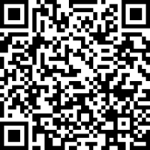
Any Questions?
To find out more
If you’d like more information or would like to offer feedback or enquire about about potential collaboration please let us know
https://northumbriaknowledgebank.flintbox.com/technologies/f31b7879-f1cc-469e-81c4-e16fd12de61c

Slide 63


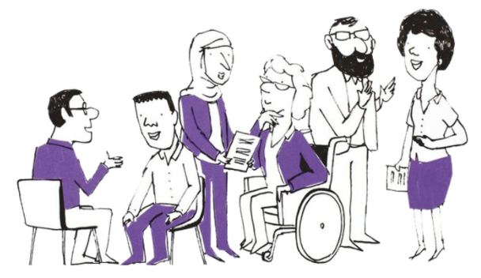

Psychological Professions Ambassadors:
Inspiring, attracting and diversifying the next generation of the workforce

Slide 64

…fulfil our ambition that more healthcare
staff are recruited from the communities they serve healthcare staff are recruited from the communities they serve

Slide 65
2024 PP Census
Demographic data

Slide 66
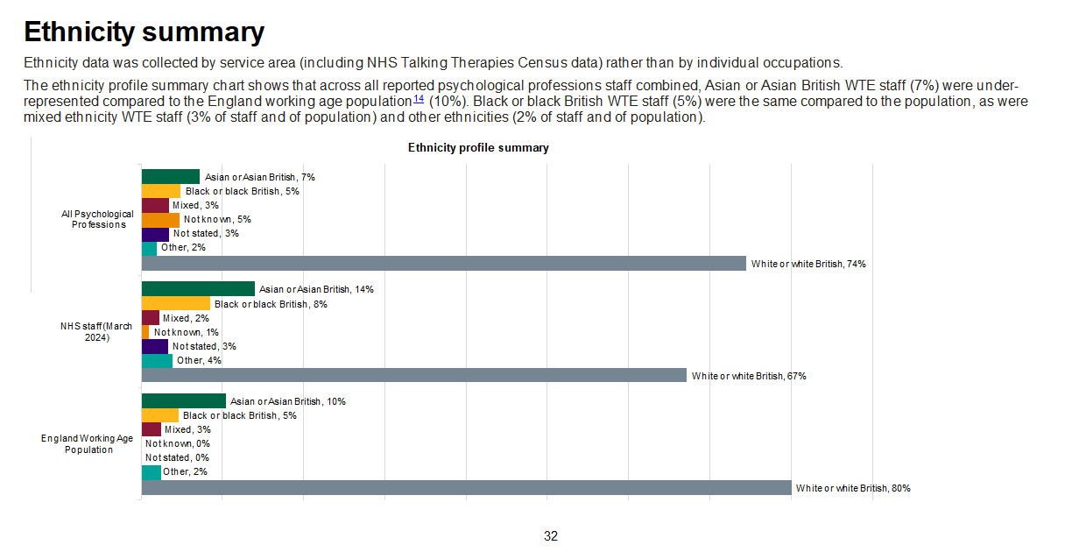
ws
2024 PP Census
Demographic data

Slide 67
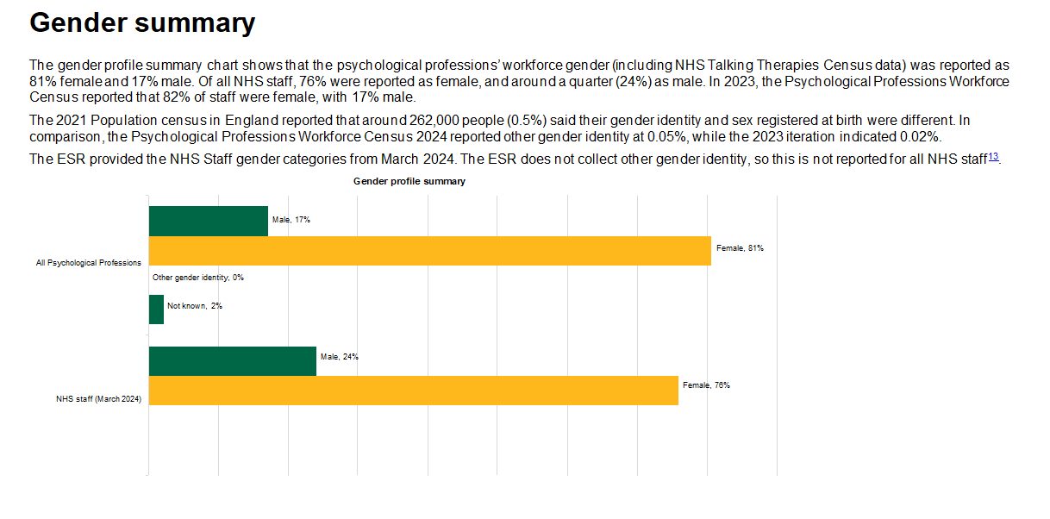
ws
2024 PP Census
Demographic data
AR Cop
EDI tool

Slide 68
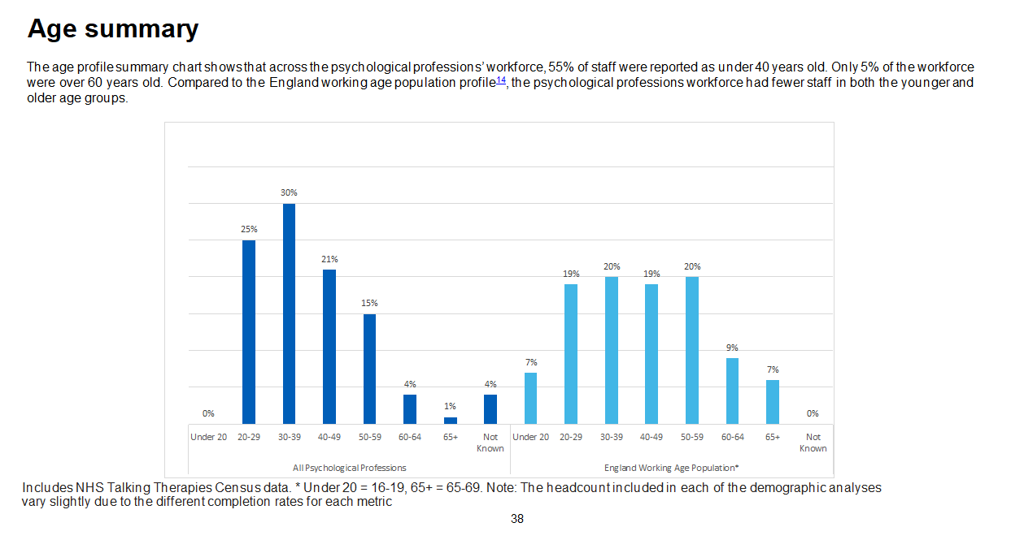
Header
sub-header

Slide 69
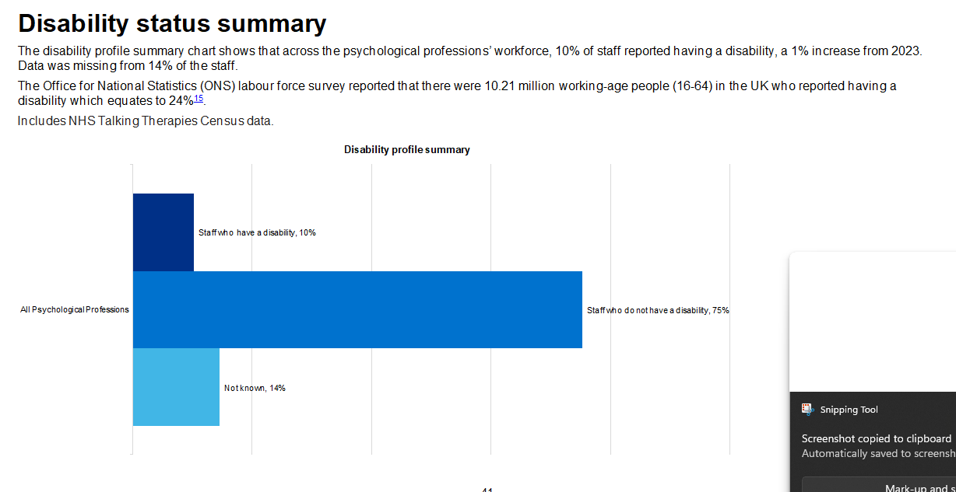
ws
2024 PP Census
Demographic data

Slide 70
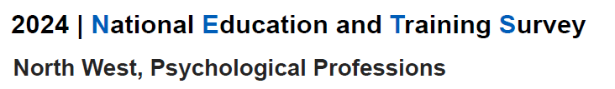
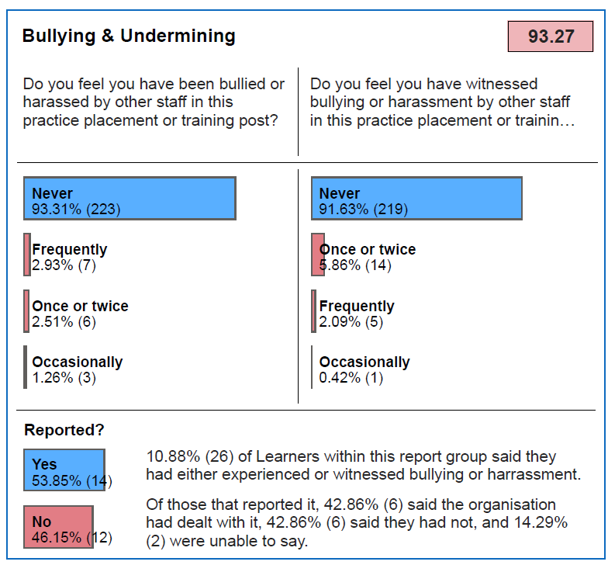
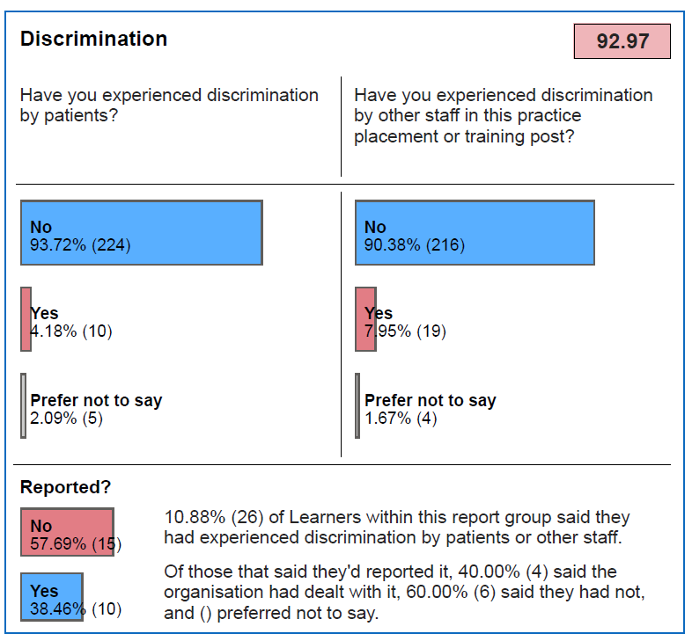
ws

Slide 71
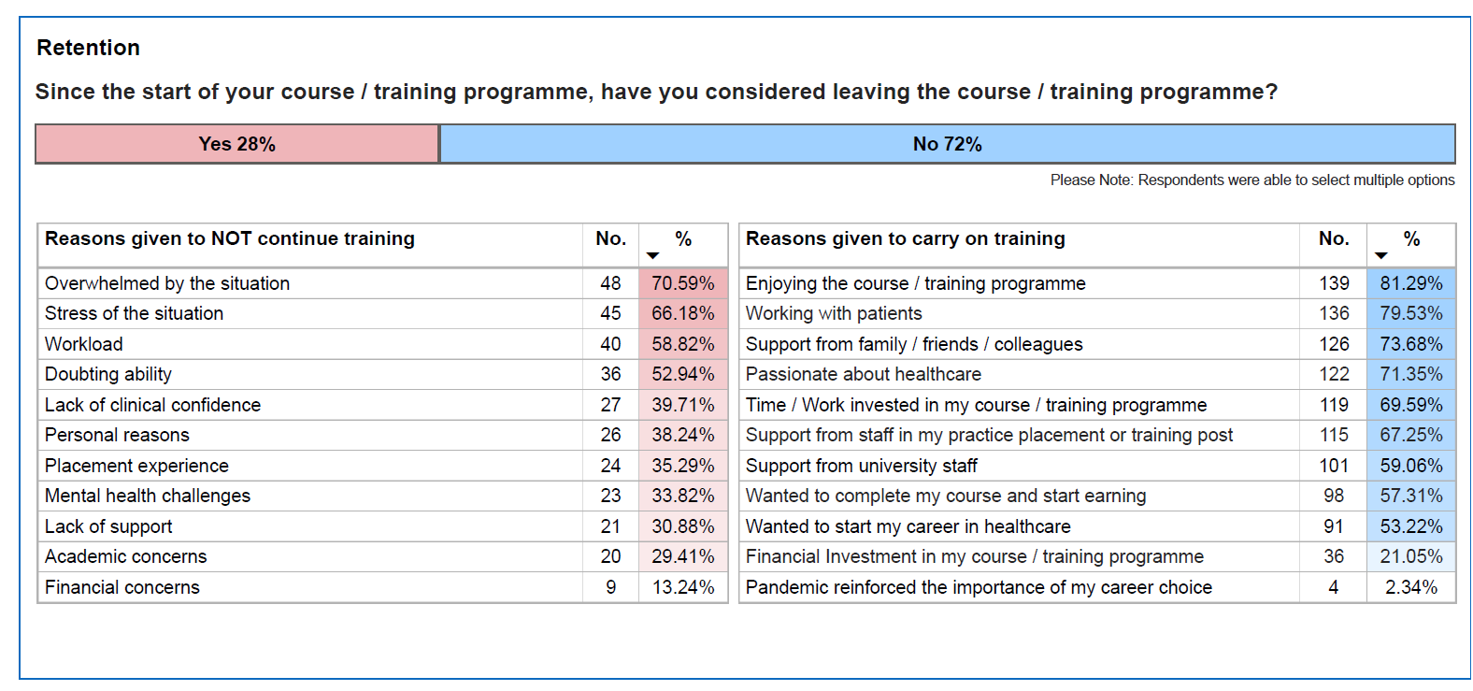
ws

Slide 72
PP Ambassadors

Slide 73
PP Strapline
PPN NW Conference 2024
Listening and talking with you to help make sense
of what you are going through and to feel better

Slide 74
Additional Work

Slide 75
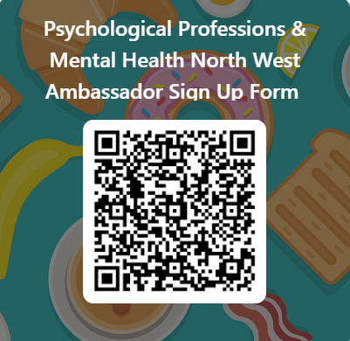
PP Ambassadors
PPN NW Conference 2024

Slide 76
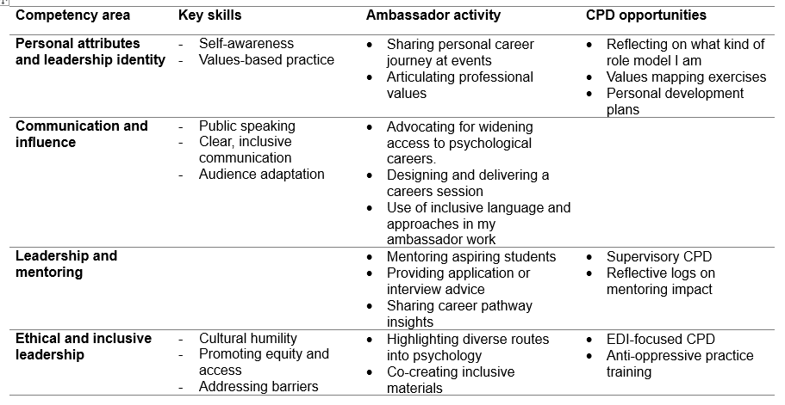
w
Ambassador
Leadership Competencies

Slide 77
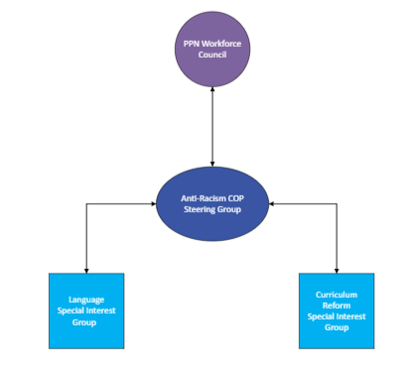
Communities of Practice
Anti-Racism

Slide 78
The EDI Recruitment Audit
An EDI audit tool to evaluate practices involved in the recruitment, training and support of the following groups
Developed by PPN SE alongside Experts by Experience and the PPN SE widening participation steering group.
Expert by Experience | Psychological Workforce | Student/Trainee
Recruitment and involvement | Workforce Recruitment Workforce Support | Improving Access to Training Adapting Teaching Supporting Trainees
Notes:
What it actually is
Three versions
Broken into sections, with questions within them – will look at some examples in a moment… but questions look down into specifics i.e. mixed interview panels – representative of….

Slide 79
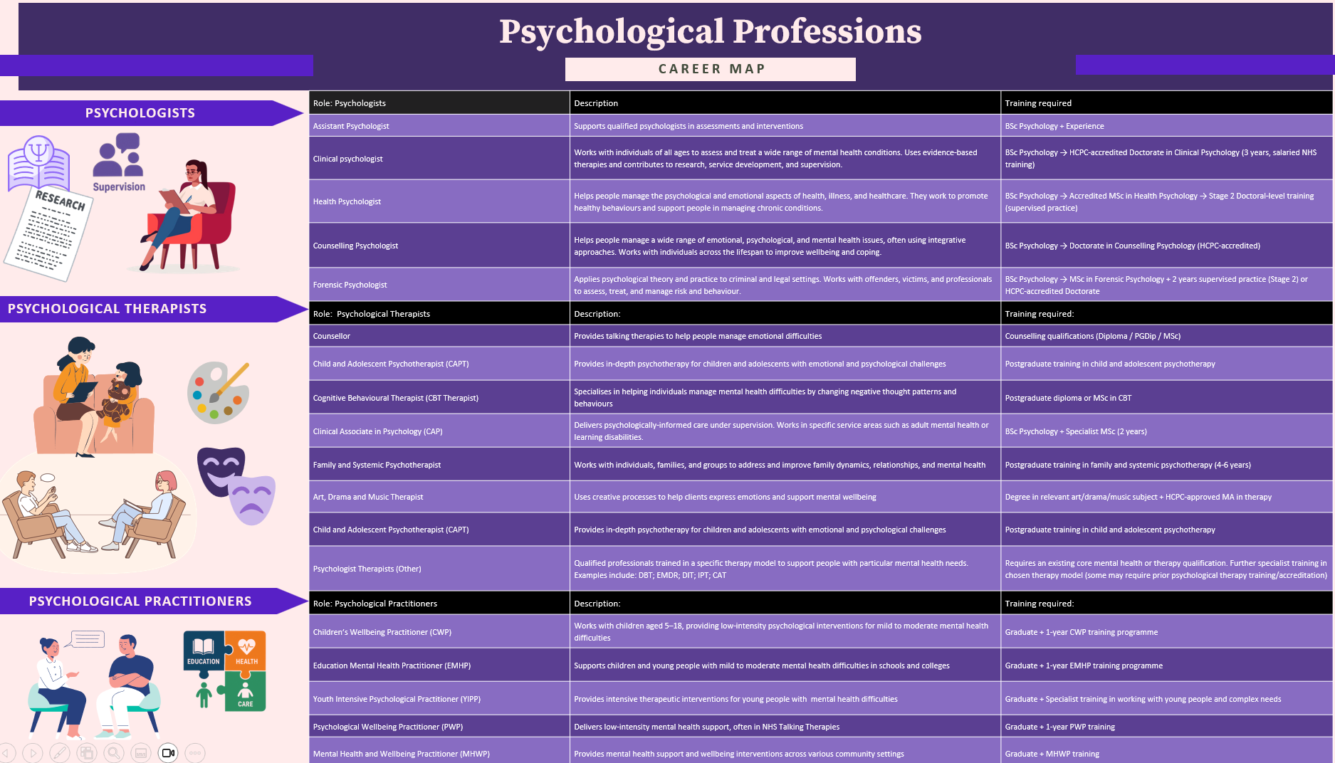
ws
Ambassador Resources
Resources for Ambassadors

Slide 80
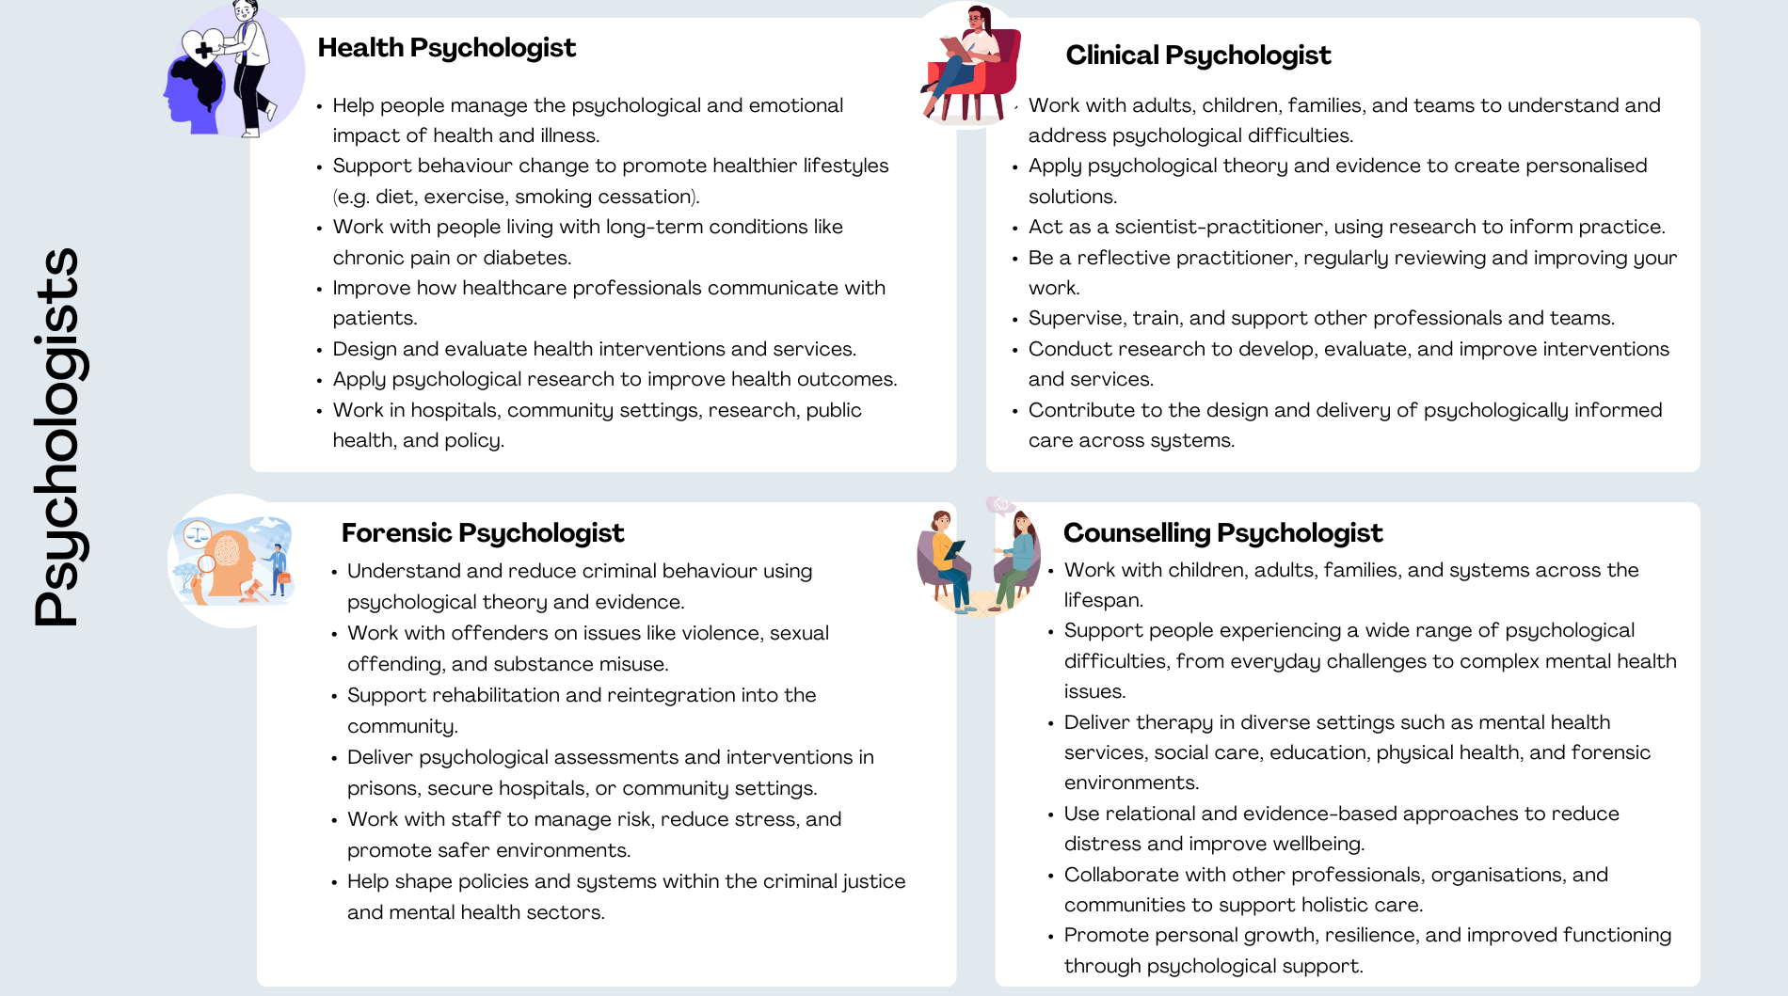
w
Ambassador Resources

Slide 81
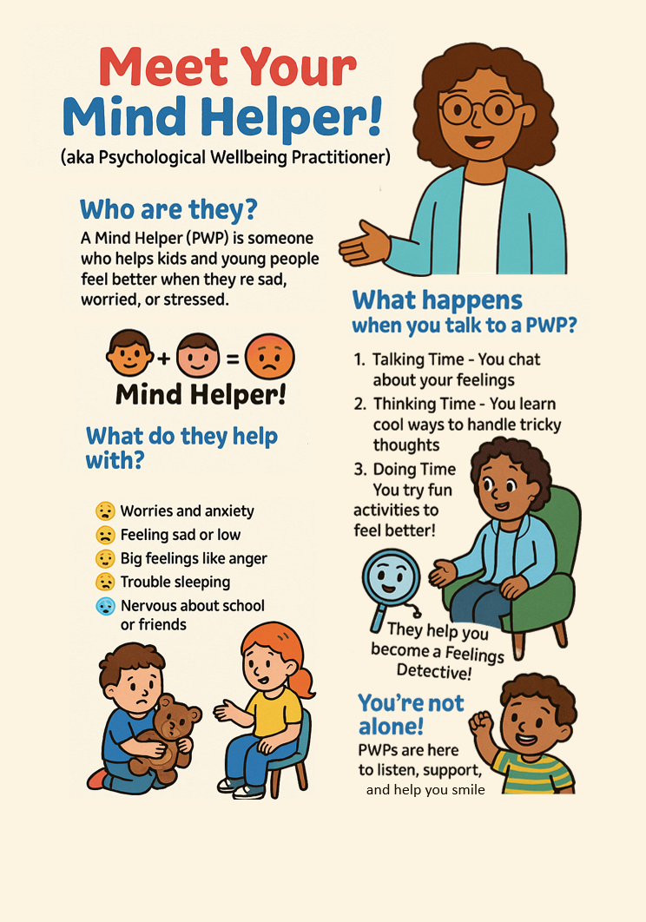
w
Ambassador Resources
Pupil/Educator resources

Slide 82

Thank you
@[twitter]
www.ppn.nhs.uk

